Slide 1

Lecture on CSE 1201 Data Structure
Prof. Dr. M. N. I Mondal
Dept. of CSE, RUET
Rajshahi-6204

Slide 2
Lecture on CSE 1201: Data Structure
Syllabus:
Introduction: Concepts and Example of Elementary Data Objects, Necessity of Structured Data, Types of Data Structure, Ideas on Linear and Nonlinear Data Structure.
Linear Array: Linear Array and its Representation in memory, Traversing LA, Insertion and Deletion in LA, Bubble Sort, Linear Search and Binary Search, Multidimensional Array and Its Representation in memory, Algebra of Matrices, Sparse Matrices.
Stack: Stack Representation and Applications, PUSH and POP operation on Stack, Polish Notation, Reverse Polish Notation, Evaluation of a Postfix Expression, Transforming Infix Expression into Postfix Expression.
Queue: Its Representation, Insertion and Deletion in Queue, Priority Queues, Recursion (Factorial function, Fibonacci sequence, Ackermann function, Tower of Hanoi).
Linked List: Linked List and its representation in memory, Traversing, Searching, Insertion and Deletion operation on Linked List, Circular List, Header Linked Lists, Two Way Lists.
Complexity: Algorithm and Flow Chart, Complexity of Algorithms, Rate of Growth, Big O Notation, Complexity of Linear Search, Binary Search and Bubble Sort Algorithm.
Sorting: Insertion Sort, Selection Sort, Quick Sort, Merge Sort, Searching and Data Modification, Hash Function, Collision Resolution, Chaining.
Tree: Tree Terminology, Representation of Binary Trees in memory, Traversing Binary Tree, Binary Search Tree, Insertion and Deletion on Binary Search Tree, Insertion and Deletion on Heap, Heap Sort, B Trees, General Tree.
@ Mondal, Dept . Of CSE, RUET

Slide 3
Computer Algorithms
Complexity: Algorithm and Flow Chart, Complexity of Algorithms, Rate of Growth, Big O Notation
An algorithm is a procedure (a finite set of well-defined instructions) for accomplishing some tasks which,
given an initial state
terminate in a defined end-state
The computational complexity and efficient implementation of the algorithm are important in computing, and this depends on suitable data structures.
Lecture on CSE 1201: Data Structure
@ Mondal, Dept . Of CSE, RUET

Slide 4
Implementation, Testing, Maintenance
Complexity: Algorithm and Flow Chart, Complexity of Algorithms, Rate of Growth, Big O Notation
Implementation
Decide on the programming language to use
C, C++, Lisp, Java, Perl, Prolog, assembly, etc. , etc.
Write clean, well documented code
Test, test, test
Integrate feedback from users, fix bugs, ensure compatibility across different versions → Maintenance
Lecture on CSE 1201: Data Structure
@ Mondal, Dept . Of CSE, RUET

Slide 5
Algorithm Analysis
Complexity: Algorithm and Flow Chart, Complexity of Algorithms, Rate of Growth, Big O Notation
Space complexity
How much space is required
Time complexity
How much time does it take to run the algorithm
Often, we deal with estimates!
Lecture on CSE 1201: Data Structure
@ Mondal, Dept . Of CSE, RUET

Slide 6
Space Complexity
Complexity: Algorithm and Flow Chart, Complexity of Algorithms, Rate of Growth, Big O Notation
Space complexity = The amount of memory required by an algorithm to run to completion
[Core dumps = the most often encountered cause is “dangling pointers”]
Some algorithms may be more efficient if data completely loaded into memory
Need to look also at system limitations
E.g. Classify 2GB of text in various categories [politics, tourism, sport, natural disasters, etc.] – can I afford to load the entire collection?
Lecture on CSE 1201: Data Structure
@ Mondal, Dept . Of CSE, RUET

Slide 7
Space Complexity (cont’d)
Complexity: Algorithm and Flow Chart, Complexity of Algorithms, Rate of Growth, Big O Notation
Fixed part: The size required to store certain data/variables, that is independent of the size of the problem:
- e.g. name of the data collection
- same size for classifying 2GB or 1MB of texts
Variable part: Space needed by variables, whose size is dependent on the size of the problem:
- e.g. actual text
- load 2GB of text VS. load 1MB of text
Lecture on CSE 1201: Data Structure
@ Mondal, Dept . Of CSE, RUET

Slide 8
Space Complexity (cont’d)
Complexity: Algorithm and Flow Chart, Complexity of Algorithms, Rate of Growth, Big O Notation
S(P) = c + S(instance characteristics)
c = constant
Example:
float summation(const float (&a)[10], int n )
{
float s = 0;
int i;
for(i = 0; i<n; i++) {
s+= a[i];
}
return s;
}
Space? one for n, one for a [passed by reference!], one for i → constant space!
Lecture on CSE 1201: Data Structure
@ Mondal, Dept . Of CSE, RUET

Slide 9
Time Complexity
Complexity: Algorithm and Flow Chart, Complexity of Algorithms, Rate of Growth, Big O Notation
Often more important than space complexity
space available (for computer programs!) tends to be larger and larger
time is still a problem for all of us
3-4GHz processors on the market
still …
researchers estimate that the computation of various transformations for 1 single DNA chain for one single protein on 1 TerraHZ computer would take about 1 year to run to completion
Algorithms running time is an important issue
Lecture on CSE 1201: Data Structure
@ Mondal, Dept . Of CSE, RUET

Slide 10
Running time
Complexity: Algorithm and Flow Chart, Complexity of Algorithms, Rate of Growth, Big O Notation
Suppose the program includes an if-then statement that may execute or not: → variable running time
Typically algorithms are measured by their worst case
Lecture on CSE 1201: Data Structure
@ Mondal, Dept . Of CSE, RUET

Slide 11
Running Time
Complexity: Algorithm and Flow Chart, Complexity of Algorithms, Rate of Growth, Big O Notation
The running time of an algorithm varies with the inputs, and typically grows with the size of the inputs.
To evaluate an algorithm or to compare two algorithms, we focus on their relative rates of growth wrt the increase of the input size.
The average running time is difficult to determine.
We focus on the worst case running time
Easier to analyze
Crucial to applications such as finance, robotics, and games
Lecture on CSE 1201: Data Structure
@ Mondal, Dept . Of CSE, RUET

Slide 12
Running Time
Complexity: Algorithm and Flow Chart, Complexity of Algorithms, Rate of Growth, Big O Notation
Problem: prefix averages
Given an array X
Compute the array A such that A[i] is the average of elements X[0] … X[i], for i=0..n-1
Sol 1
At each step i, compute the element X[i] by traversing the array A and determining the sum of its elements, respectively the average
Sol 2
At each step i update a sum of the elements in the array A
Compute the element X[i] as sum/I
Big question: Which solution to choose?
Lecture on CSE 1201: Data Structure
@ Mondal, Dept . Of CSE, RUET

Slide 13
Experimental Approach
Complexity: Algorithm and Flow Chart, Complexity of Algorithms, Rate of Growth, Big O Notation
Write a program to implement the algorithm.
Run this program with inputs of varying size and composition.
Get an accurate measure of the actual running time (e.g. system call date).
Plot the results.
Problems?
Lecture on CSE 1201: Data Structure
@ Mondal, Dept . Of CSE, RUET

Slide 14
Limitations of Experimental Studies
Complexity: Algorithm and Flow Chart, Complexity of Algorithms, Rate of Growth, Big O Notation
The algorithm has to be implemented, which may take a long time and could be very difficult.
Results may not be indicative for the running time on other inputs that are not included in the experiments.
In order to compare two algorithms, the same hardware and software must be used.
Lecture on CSE 1201: Data Structure
@ Mondal, Dept . Of CSE, RUET

Slide 15
Use a Theoretical Approach
Complexity: Algorithm and Flow Chart, Complexity of Algorithms, Rate of Growth, Big O Notation
Based on high-level description of the algorithms, rather than language dependent implementations
Makes possible an evaluation of the algorithms that is independent of the hardware and software environments
→ Generality
Lecture on CSE 1201: Data Structure
@ Mondal, Dept . Of CSE, RUET

Slide 16
Pseudo code
Complexity: Algorithm and Flow Chart, Complexity of Algorithms, Rate of Growth, Big O Notation
Example: find the max element of an array
High-level description of an algorithm.
More structured than plain English.
Less detailed than a program.
Preferred notation for describing algorithms.
Hides program design issues.
Algorithm arrayMax(A, n)
Input array A of n integers
Output maximum element of A
currentMax ← A[0]
for i ← 1 to n − 1 do
if A[i] > currentMax then
currentMax ← A[i]
return currentMax
Lecture on CSE 1201: Data Structure
@ Mondal, Dept . Of CSE, RUET

Slide 17
Pseudo code
Complexity: Algorithm and Flow Chart, Complexity of Algorithms, Rate of Growth, Big O Notation
Method call
var.method (arg [, arg…])
Return value
return expression
Expressions
Assignment (equivalent to =)
Equality testing (equivalent to ==)
n² Superscripts and other mathematical formatting allowed
Control flow
if … then … [else …]
while … do …
repeat … until …
for … do …
Indentation replaces braces
Method declaration
Algorithm method (arg [, arg…])
Input …
Output …
Lecture on CSE 1201: Data Structure
@ Mondal, Dept . Of CSE, RUET

Slide 18
Primitive Operations
Complexity: Algorithm and Flow Chart, Complexity of Algorithms, Rate of Growth, Big O Notation
Examples:
Evaluating an expression
Assigning a value to a variable
Calling a method
Returning from a method
The basic computations performed by an algorithm
Identifiable in pseudocode
Largely independent from the programming language
Exact definition not important
Use comments
Instructions have to be basic enough and feasible!
Lecture on CSE 1201: Data Structure
@ Mondal, Dept . Of CSE, RUET

Slide 19
Low Level Algorithm Analysis
Complexity: Algorithm and Flow Chart, Complexity of Algorithms, Rate of Growth, Big O Notation
Based on primitive operations (low-level computations independent from the programming language)
E.g.:
Make an addition = 1 operation
Calling a method or returning from a method = 1 operation
Index in an array = 1 operation
Comparison = 1 operation etc.
Method: Inspect the pseudo-code and count the number of primitive operations executed by the algorithm
Lecture on CSE 1201: Data Structure
@ Mondal, Dept . Of CSE, RUET

Slide 20
Counting Primitive Operations
Complexity: Algorithm and Flow Chart, Complexity of Algorithms, Rate of Growth, Big O Notation
By inspecting the code, we can determine the number of primitive operations executed by an algorithm, as a function of the input size.
Algorithm arrayMax(A, n)
# operations
currentMax ← A[0] 2
for i ← 1 to n − 1 do 2 + n
if A[i] > currentMax then 2(n − 1)
currentMax ← A[i] 2(n − 1)
{ increment counter i } 2(n − 1)
return currentMax 1
Total 7n − 1
Lecture on CSE 1201: Data Structure
@ Mondal, Dept . Of CSE, RUET

Slide 21
Estimating Running Time
Complexity: Algorithm and Flow Chart, Complexity of Algorithms, Rate of Growth, Big O Notation
Algorithm arrayMax executes 7n − 1 primitive operations.
Let’s define
a:= Time taken by the fastest primitive operation
b:= Time taken by the slowest primitive operation
Let T(n) be the actual running time of arrayMax. We have a (7n − 1) ≤ T(n) ≤ b(7n − 1)
Therefore, the running time T(n) is bounded by two linear functions.
Lecture on CSE 1201: Data Structure
@ Mondal, Dept . Of CSE, RUET

Slide 22
Growth Rate of Running Time
Complexity: Algorithm and Flow Chart, Complexity of Algorithms, Rate of Growth, Big O Notation
Changing computer hardware / software
Affects T(n) by a constant factor
Does not alter the growth rate of T(n)
The linear growth rate of the running time T(n) is an intrinsic property of algorithm arrayMax
Lecture on CSE 1201: Data Structure
@ Mondal, Dept . Of CSE, RUET

Slide 23
Growth Rates
Complexity: Algorithm and Flow Chart, Complexity of Algorithms, Rate of Growth, Big O Notation
Growth rates of functions:
Linear ≈ n
Quadratic ≈ n²
Cubic ≈ n³
In a log-log chart, the slope of the line corresponds to the growth rate of the function
Lecture on CSE 1201: Data Structure
@ Mondal, Dept . Of CSE, RUET

Slide 24
Constant Factors
Complexity: Algorithm and Flow Chart, Complexity of Algorithms, Rate of Growth, Big O Notation
The growth rate is not affected by
constant factors or
lower-order terms
Examples
10²n + 10⁵ is a linear function
10⁵n² + 10⁸n is a quadratic function
Lecture on CSE 1201: Data Structure
@ Mondal, Dept . Of CSE, RUET

Slide 25
Asymptotic Notation
Complexity: Algorithm and Flow Chart, Complexity of Algorithms, Rate of Growth, Big O Notation
Need to abstract further
Give an “idea” of how the algorithm performs
n steps vs. n+5 steps
n steps vs. n² steps
Lecture on CSE 1201: Data Structure
@ Mondal, Dept . Of CSE, RUET

Slide 26
Problem
Complexity: Algorithm and Flow Chart, Complexity of Algorithms, Rate of Growth, Big O Notation
Fibonacci numbers
F[0] = 0
F[1] = 1
F[i] = F[i-1] + F[i-2] for i ≥ 2
Pseudo-code
Number of operations
Lecture on CSE 1201: Data Structure
@ Mondal, Dept . Of CSE, RUET

Slide 27
Asymptotic Complexity
Complexity: Algorithm and Flow Chart, Complexity of Algorithms, Rate of Growth, Big O Notation
comparison independent of actual data and machine used
problem size
significant step
time complexity in terms of problem size
e.g. g(n) = n²/2 + 5n/2 - 3
compare functions
approximation of g(n)
asymptotic complexity
dominant term
Lecture on CSE 1201: Data Structure
@ Mondal, Dept . Of CSE, RUET

Slide 28
Methods
Complexity: Algorithm and Flow Chart, Complexity of Algorithms, Rate of Growth, Big O Notation
big-O notation
order O(…)
order of dominant term
definition
desire lowest order function
big-Ω notation
definition
if g(n) is O(f(n)) then f(n) is Ω(g(n))
big-Θ notation
definition
if g(n) is Θ(f(n)) then g(n) is O(f(n)) and g(n) is Ω(f(n))
comparison
complexity classes
polynomial
non-polynomial
Lecture on CSE 1201: Data Structure
@ Mondal, Dept . Of CSE, RUET

Slide 29
Determining Complexity
Complexity: Algorithm and Flow Chart, Complexity of Algorithms, Rate of Growth, Big O Notation
informal analysis
rough count of significant step
constant time (O(1))
number of times independent of n
linear code
loops
if number of times is a factor of n
order is the order of the factor
nested code
nesting rule
sum of the orders
sequential code
sequence rule
maximum of the orders
examples
Lecture on CSE 1201: Data Structure
@ Mondal, Dept . Of CSE, RUET

Slide 30
Timing Algorithms
Complexity: Algorithm and Flow Chart, Complexity of Algorithms, Rate of Growth, Big O Notation
determining actual run-time of algorithm
data?
representative set
System.currentTimeMillis
timing
example – methods of different order
results
accuracy of results
Lecture on CSE 1201: Data Structure
@ Mondal, Dept . Of CSE, RUET

Slide 31
Complexity: Algorithm and Flow Chart, Complexity of Algorithms, Rate of Growth, Big O Notation
Lecture on CSE 1201: Data Structure
@ Mondal, Dept . Of CSE, RUET

Slide 32
Complexity: Algorithm and Flow Chart, Complexity of Algorithms, Rate of Growth, Big O Notation
Lecture on CSE 1201: Data Structure
@ Mondal, Dept . Of CSE, RUET

Slide 33
Complexity: Algorithm and Flow Chart, Complexity of Algorithms, Rate of Growth, Big O Notation
Lecture on CSE 1201: Data Structure
@ Mondal, Dept . Of CSE, RUET

Slide 34
Complexity: Algorithm and Flow Chart, Complexity of Algorithms, Rate of Growth, Big O Notation
Lecture on CSE 1201: Data Structure
@ Mondal, Dept . Of CSE, RUET

Slide 36
Complexity: Algorithm and Flow Chart, Complexity of Algorithms, Rate of Growth, Big O Notation
Lecture on CSE 1201: Data Structure
@ Mondal, Dept . Of CSE, RUET

Slide 37
Complexity: Algorithm and Flow Chart, Complexity of Algorithms, Rate of Growth, Big O Notation
Lecture on CSE 1201: Data Structure
@ Mondal, Dept . Of CSE, RUET

Slide 38
Complexity: Algorithm and Flow Chart, Complexity of Algorithms, Rate of Growth, Big O Notation
Lecture on CSE 1201: Data Structure
@ Mondal, Dept . Of CSE, RUET

Slide 39
Complexity: Algorithm and Flow Chart, Complexity of Algorithms, Rate of Growth, Big O Notation
Lecture on CSE 1201: Data Structure
@ Mondal, Dept . Of CSE, RUET

Slide 40
Complexity: Algorithm and Flow Chart, Complexity of Algorithms, Rate of Growth, Big O Notation
Lecture on CSE 1201: Data Structure
@ Mondal, Dept . Of CSE, RUET

Slide 41
Strategies for Analyzing Code
Complexity: Algorithm and Flow Chart, Complexity of Algorithms, Rate of Growth, Big O Notation
Rule 1-- FOR LOOPS: The running time of a FOR loop is at most the running time of the statements inside the FOR loop (including tests) times the number of iterations.
Rule 2-- Nested Loops: The total running time of a statement inside a group of nested loops is the running time of the statements multiplied by the product of the sizes of all the loops.
for (i=0; i < n; i++) for (j=0; j < n; j++) sum++;
Running time n x n
Lecture on CSE 1201: Data Structure
@ Mondal, Dept . Of CSE, RUET

Slide 42
Strategies for Analyzing Code Cont...
Complexity: Algorithm and Flow Chart, Complexity of Algorithms, Rate of Growth, Big O Notation
Rule 3-- Consecutive Statements: Statements simply add up, where the largest statement takes precedence.
for (int i = 0; i < n; i++) sum++; for (int i = 0; i < n; i++) for (int j = 0; j < n; j++) sum++;
Total running time is determined by statement set B
Statements A
Statements B
Lecture on CSE 1201: Data Structure
@ Mondal, Dept . Of CSE, RUET

Slide 43
Strategies for Analyzing Code Cont...
Complexity: Algorithm and Flow Chart, Complexity of Algorithms, Rate of Growth, Big O Notation
Rule 4-- If/Else: Running time of an IF/ELSE is never more than the running time of the test plus the larger of the running times of S1 and S2.
Worst case is condition + S2 = O(n²)
If (condition)
S1
Else
S2
If (condition)
for (int i = 0; i < n; i++) sum++;
Else
for (int i = 0; i < n; i++) for (int j = 0; j < n; j++) sum++;
Lecture on CSE 1201: Data Structure
@ Mondal, Dept . Of CSE, RUET

Slide 44
Strategies for Analyzing Code Cont...
Complexity: Algorithm and Flow Chart, Complexity of Algorithms, Rate of Growth, Big O Notation
Loops where the problem N size is divided by some factor k is a log_{k}N loop.
for (int i = 0; i < n; i++){
n = n/3;
sum++;
}
Running time is log₃N
or
Just O(log N)
Lecture on CSE 1201: Data Structure
@ Mondal, Dept . Of CSE, RUET

Slide 45
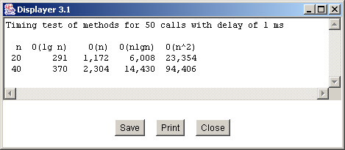
Timing Algorithms
Complexity: Algorithm and Flow Chart, Complexity of Algorithms, Rate of Growth, Big O Notation
Define variables to hold before and after time
long t1; // time before execution
long t2; // time after execution
int i;
out.writeLabel("Timing test of methods for ");
out.writeInt(NUM_TESTS);
out.writeLabel(" calls with delay of ");
out.writeLong(DELAY);
out.writeLabel(" ms");
out.writeEOL();
out.writeEOL();
out.writeLabel(" n O(lg n) O(n) O(nlgn) O(n^2)");
out.writeEOL();
out.writeInt(SIZE,3);
t1 = System.currentTimeMillis();
for ( i=1 ; i<=NUM_TESTS ; i++ ) {
lgNMethod(SIZE);
};
t2 = System.currentTimeMillis();
out.writeLong(t2-t1,8);
Get system time after function call.
Get the current system time in msecs.
Call the function g(n).
Total elapsed time is the difference between the observed values
Lecture on CSE 1201: Data Structure
@ Mondal, Dept . Of CSE, RUET

Slide 46
Timing Algorithms.
Complexity: Algorithm and Flow Chart, Complexity of Algorithms, Rate of Growth, Big O Notation
N determines the problem size.
How the algorithm behaves w.r.t. n. This give a logarithmic response
private void lgNMethod ( int n ) {
int i;
for ( i=1 ; i<=n ; i=i*2 ) {
try { Thread.sleep(DELAY); }
catch ( InterruptedException e ) { };
};
}; // lgNMethod
private void linearMethod ( int n ) {
int i;
for ( i=1 ; i<=n ; i++ ) {
try { Thread.sleep(DELAY); }
catch ( InterruptedException e ) { };
};
}; // linearMethod
private void nLgNMethod ( int n ) {
int i, j;
for ( i=1 ; i<=n ; i++ ) {
for ( j=1 ; j<=n ; j=j*2 ) {
try { Thread.sleep(DELAY); }
catch ( InterruptedException e ) { };
};
};
}; // linearMethod
private void quadraticMethod ( int n ) {
int i, j;
for ( i=1 ; i<=n ; i++ ) {
for ( j=1 ; j<=n ; j++ ) {
try { Thread.sleep(DELAY); }
catch ( InterruptedException e ) { };
};
};
}; // quadraticMethod
Loop is based on n, so linear response
Outer loop is linear.
Combining them we get n*log(n)
Inner loop is logarithmic.
To get the 1 msec delay. The try-catch clause is the exception handler that the timer requires.
Outer is n, Inner is n, total n*n
Lecture on CSE 1201: Data Structure
@ Mondal, Dept . Of CSE, RUET

Slide 47
Selection Sorting Algorithm
Complexity: Algorithm and Flow Chart, Complexity of Algorithms, Rate of Growth, Big O Notation
void SelectionSort(InputArray A)
{
int MinPosition, temp, i, j;
for (i=n-1; i>0; --i){
MinPosition=i;
for (j=0; j<i; ++i){
if (A[j] < A[MinPosition]){
MinPosition=j;
}
}
temp=A[i];
A[i]=A[MinPosition];
A[MinPosition]=temp;
}
}
Lecture on CSE 1201: Data Structure
@ Mondal, Dept . Of CSE, RUET

Slide 48
Running Times in Seconds to Sort an Array of 2000 Integers
Complexity: Algorithm and Flow Chart, Complexity of Algorithms, Rate of Growth, Big O Notation
Computers A, B, etc. up to E are progressively faster.
The algorithm runs faster on faster computers.
Type of Computer | Time
Computer A | 51.915
Computer B | 11.508
Computer C | 2.382
Computer D | 0.431
Computer E | 0.087
Lecture on CSE 1201: Data Structure
@ Mondal, Dept . Of CSE, RUET

Slide 49
More Measurements
Complexity: Algorithm and Flow Chart, Complexity of Algorithms, Rate of Growth, Big O Notation
In addition to trying different computers, we should try different programming languages and different compilers.
Shall we take all these measurements to decide whether an algorithm is better than another one?
Lecture on CSE 1201: Data Structure
@ Mondal, Dept . Of CSE, RUET

Slide 50
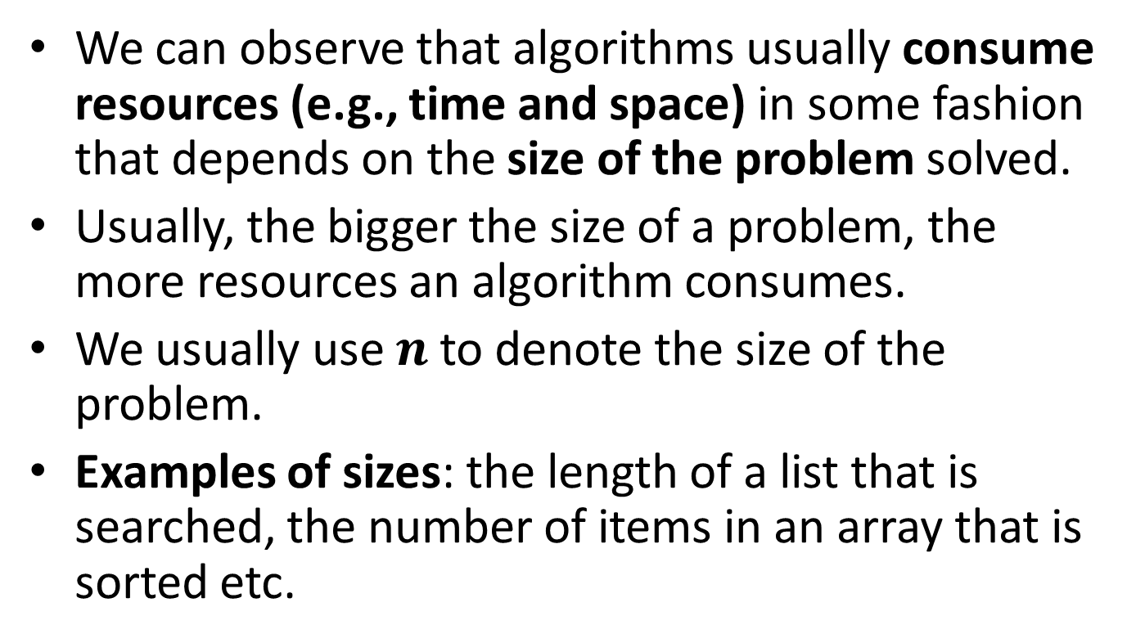
A More Meaningful Criterion
Complexity: Algorithm and Flow Chart, Complexity of Algorithms, Rate of Growth, Big O Notation
We can observe that algorithms usually consume resources (e.g., time and space) in some fashion that depends on the size of the problem solved.
Usually, the bigger the size of a problem, the more resources an algorithm consumes.
We usually use $n$ to denote the size of the problem.
Examples of sizes: the length of a list that is searched, the number of items in an array that is sorted etc.
Lecture on CSE 1201: Data Structure
@ Mondal, Dept . Of CSE, RUET

Slide 51
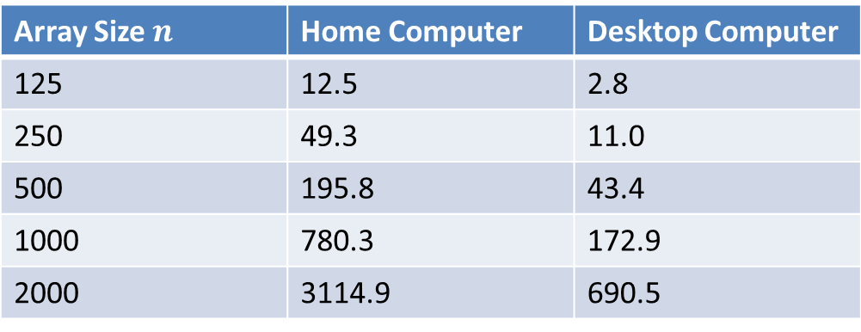
SelectionSort Running Times in Milliseconds on Two Types of Computers
Complexity: Algorithm and Flow Chart, Complexity of Algorithms, Rate of Growth, Big O Notation
 | Home Computer | Desktop Computer
125 | 12.5 | 2.8
250 | 49.3 | 11.0
500 | 195.8 | 43.4
1000 | 780.3 | 172.9
2000 | 3114.9 | 690.5
Lecture on CSE 1201: Data Structure
@ Mondal, Dept . Of CSE, RUET

Slide 52
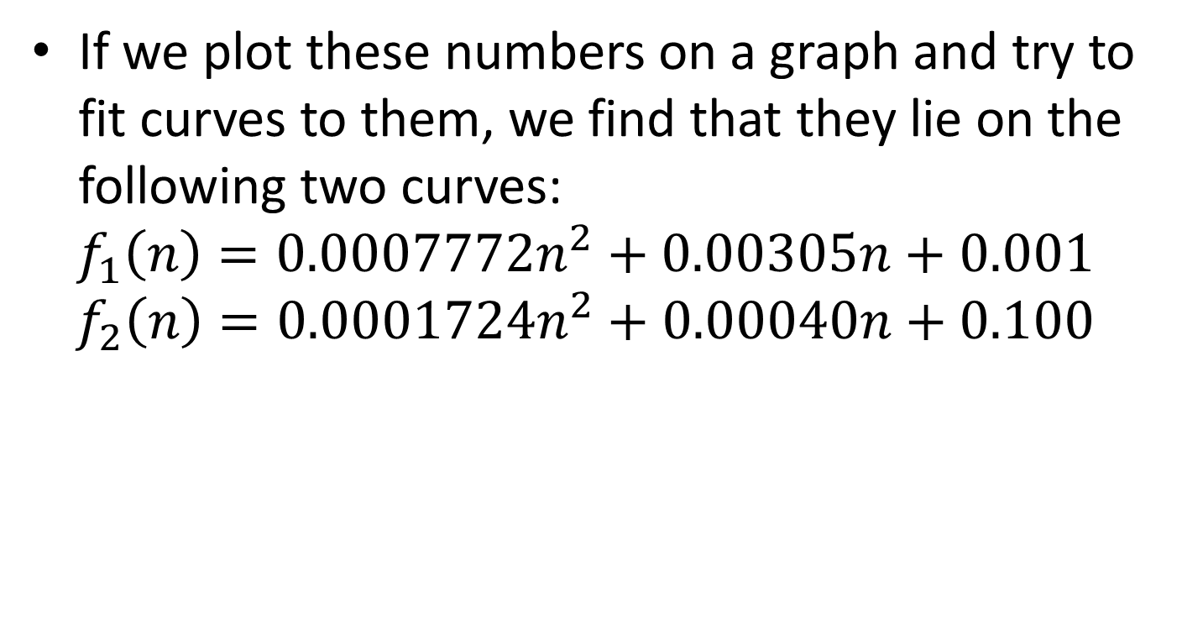
Two Curves Fitting the Previous Data
Complexity: Algorithm and Flow Chart, Complexity of Algorithms, Rate of Growth, Big O Notation
Lecture on CSE 1201: Data Structure
@ Mondal, Dept . Of CSE, RUET

Slide 53
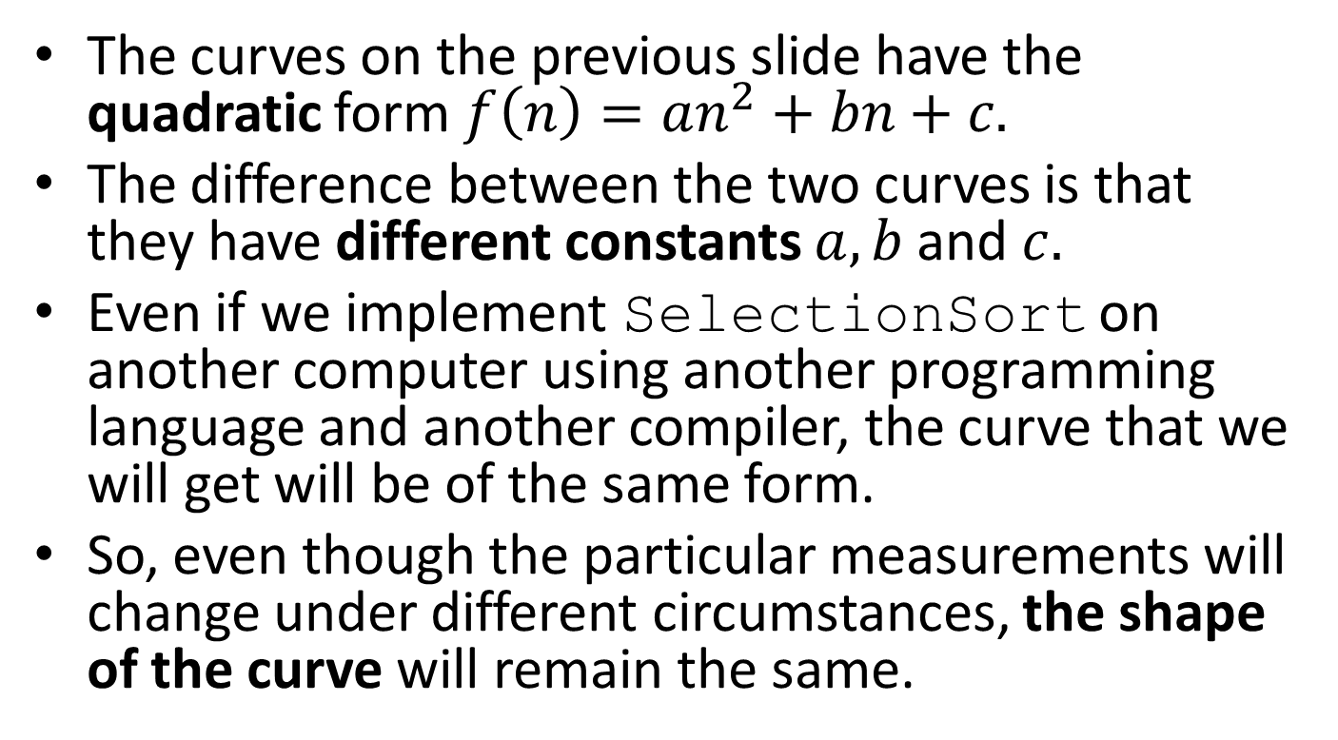
Discussion:
Complexity: Algorithm and Flow Chart, Complexity of Algorithms, Rate of Growth, Big O Notation
The curves on the previous slide have the quadratic form $f\left(n\right)=an^{2}+bn+c.$
The difference between the two curves is that they have different constants $a,b$and $c.$
Even if we implement SelectionSort on another computer using another programming language and another compiler, the curve that we will get will be of the same form.
So, even though the particular measurements will change under different circumstances, the shape of the curve will remain the same.
Lecture on CSE 1201: Data Structure
@ Mondal, Dept . Of CSE, RUET

Slide 54
Complexity Classes:
Complexity: Algorithm and Flow Chart, Complexity of Algorithms, Rate of Growth, Big O Notation
The running times of various algorithms belong to different complexity classes.
Each complexity class is characterized by a different family of curves.
All of the curves in a given complexity class share the same basic shape. The shape is characterized by an equation that gives running times as a function of problem size.
Lecture on CSE 1201: Data Structure
@ Mondal, Dept . Of CSE, RUET

Slide 55

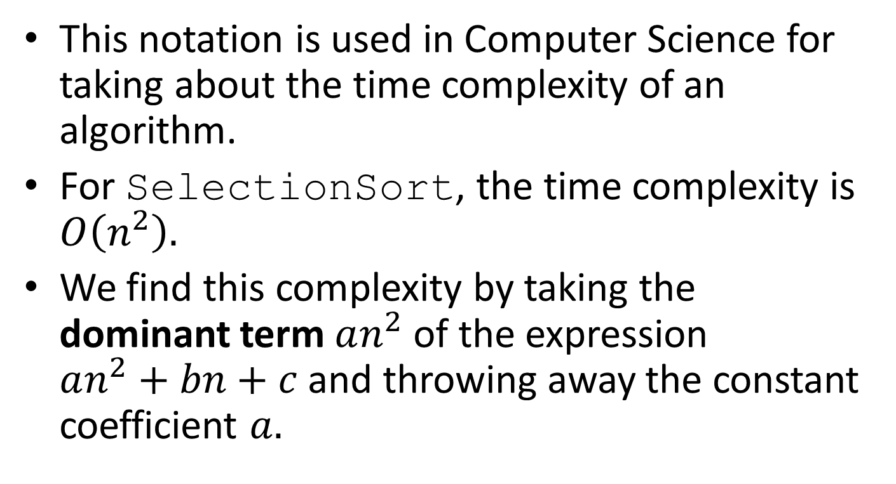
Complexity: Algorithm and Flow Chart, Complexity of Algorithms, Rate of Growth, Big O Notation
This notation is used in Computer Science for taking about the time complexity of an algorithm.
For SelectionSort, the time complexity is $O\left(n^{2}\right).$
We find this complexity by taking the dominant term $an^{2}$ of the expression $an^{2}+bn+c$ and throwing away the constant coefficient $a.$
Lecture on CSE 1201: Data Structure
@ Mondal, Dept . Of CSE, RUET

Slide 56


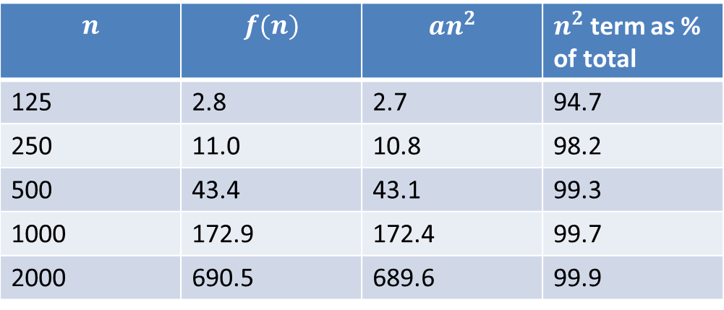
$O$-notation (cont’d)
Complexity: Algorithm and Flow Chart, Complexity of Algorithms, Rate of Growth, Big O Notation
Let us consider the equation $f\left(n\right)=an^{2}+bn+c$ with $a=0.0001724$, $b=0.0004$ and $c=0.1$. Then we have the following table:
$$n$$ | $$f(n)$$ | $${an}^{2}$$ | $n^{2}$ term as % of total
125 | 2.8 | 2.7 | 94.7
250 | 11.0 | 10.8 | 98.2
500 | 43.4 | 43.1 | 99.3
1000 | 172.9 | 172.4 | 99.7
2000 | 690.5 | 689.6 | 99.9
Lecture on CSE 1201: Data Structure
@ Mondal, Dept . Of CSE, RUET

Slide 57
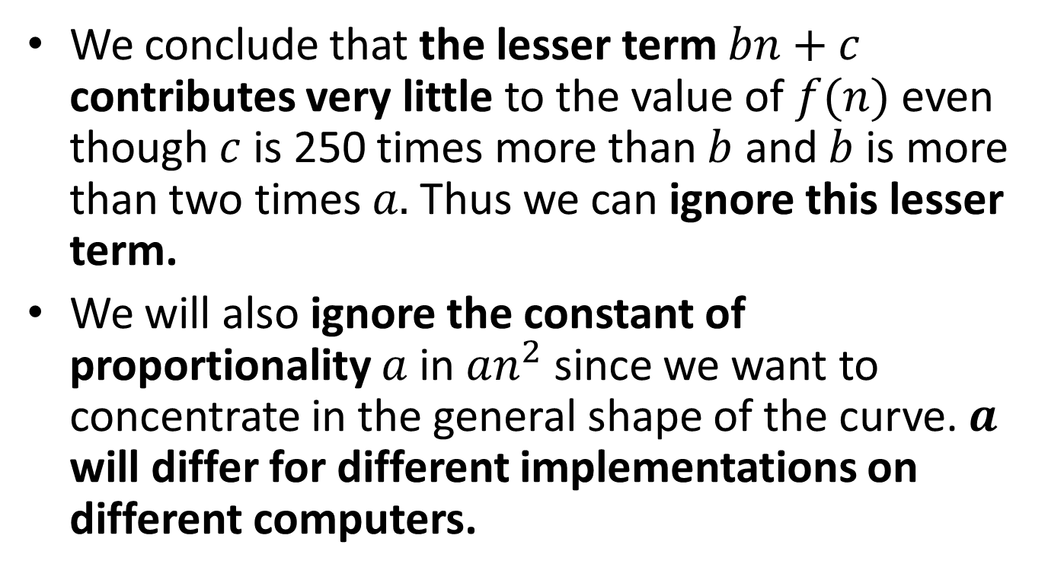
$O$-notation (cont’d)
Complexity: Algorithm and Flow Chart, Complexity of Algorithms, Rate of Growth, Big O Notation
We conclude that the lesser term $bn+c$contributes very little to the value of $f(n)$ even though $c$ is 250 times more than $b$ and $b$is more than two times $a.$ Thus we can ignore this lesser term.
We will also ignore the constant of proportionality$a$ in $an^{2}$ since we want to concentrate in the general shape of the curve. $a$ will differ for different implementations on different computers.
Lecture on CSE 1201: Data Structure
@ Mondal, Dept . Of CSE, RUET

Slide 58
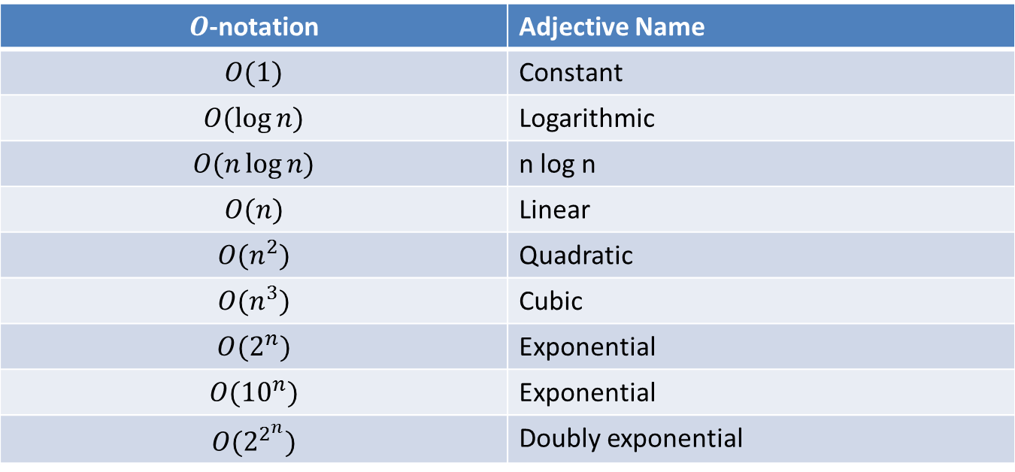
Some Common Complexity Classes
Complexity: Algorithm and Flow Chart, Complexity of Algorithms, Rate of Growth, Big O Notation
$O$-notation | Adjective Name
$$O(1)$$ | Constant
$$O(\log{n)}$$ | Logarithmic
$$O(n\log{n)}$$ | n log n
$$O(n)$$ | Linear
$$O(n^{2})$$ | Quadratic
$$O(n^{3})$$ | Cubic
$$O(2^{n})$$ | Exponential
$$O({10}^{n})$$ | Exponential
$$O(2^{2^{n}})$$ | Doubly exponential
Lecture on CSE 1201: Data Structure
@ Mondal, Dept . Of CSE, RUET

Slide 59
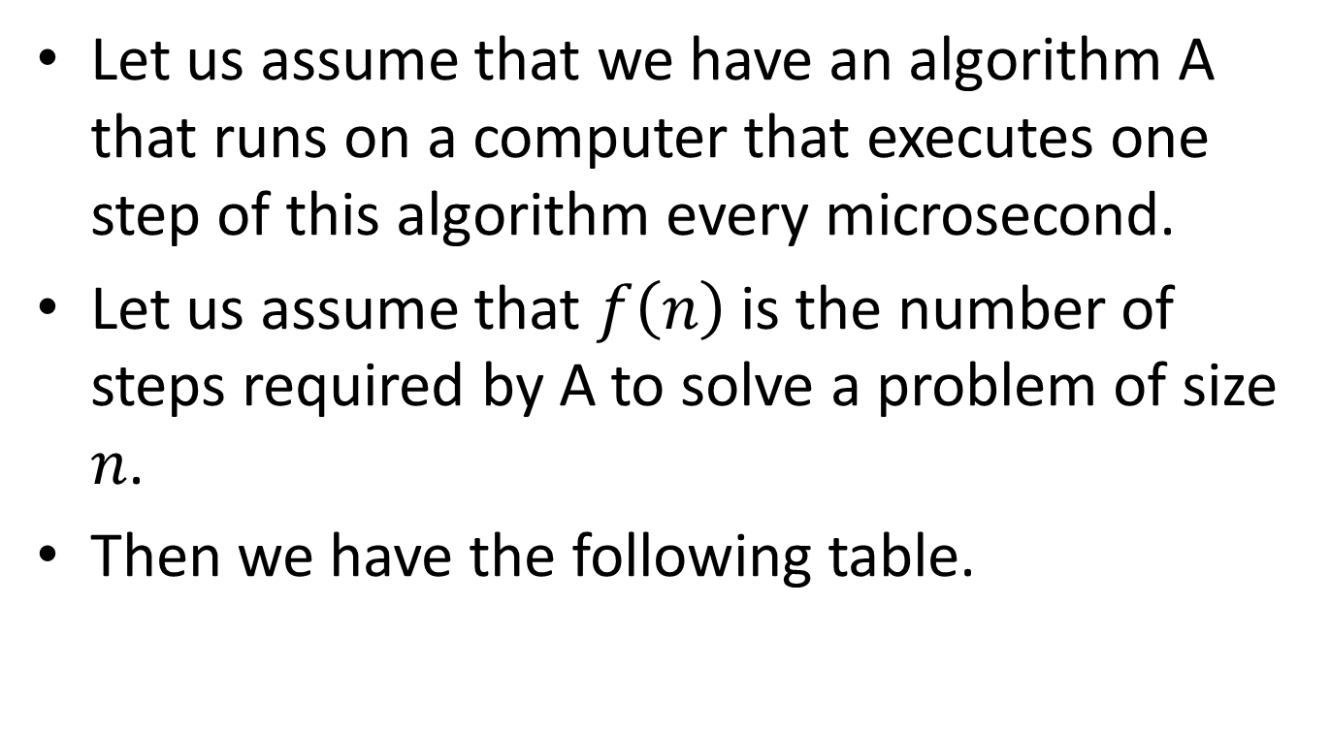
Comparing Complexity Classes
Complexity: Algorithm and Flow Chart, Complexity of Algorithms, Rate of Growth, Big O Notation
Let us assume that we have an algorithm A that runs on a computer that executes one step of this algorithm every microsecond.
Let us assume that $f\left(n\right)$is the number of steps required by A to solve a problem of size $n$.
Then we have the following table.
Lecture on CSE 1201: Data Structure
@ Mondal, Dept . Of CSE, RUET

Slide 60
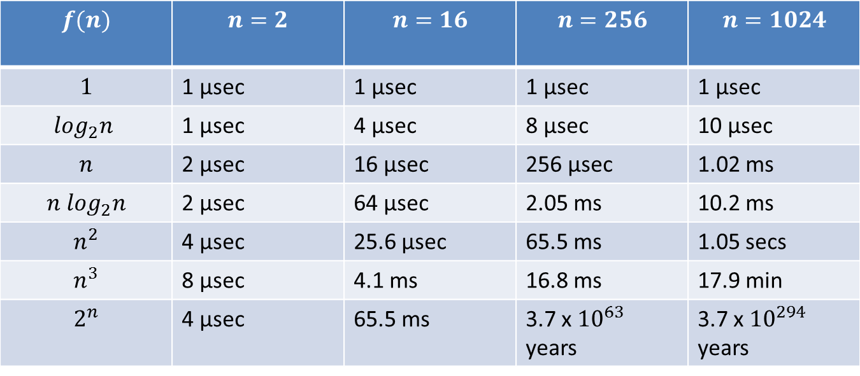
Running Times for Algorithm A
Complexity: Algorithm and Flow Chart, Complexity of Algorithms, Rate of Growth, Big O Notation
$$f(n)$$ | $$n=2$$ | $$n=16$$ | $$n=256$$ | $$n=1024$$
$$1$$ | 1 μsec | 1 μsec | 1 μsec | 1 μsec
$$\log_{2}n$$ | 1 μsec | 4 μsec | 8 μsec | 10 μsec
$$n$$ | 2 μsec | 16 μsec | 256 μsec | 1.02 ms
$${n log}_{2}n$$ | 2 μsec | 64 μsec | 2.05 ms | 10.2 ms
$$n^{2}$$ | 4 μsec | 25.6 μsec | 65.5 ms | 1.05 secs
$$n^{3}$$ | 8 μsec | 4.1 ms | 16.8 ms | 17.9 min
$$2^{n}$$ | 4 μsec | 65.5 ms | 3.7 x ${10}^{63}$ years | 3.7 x ${10}^{294}$ years
Lecture on CSE 1201: Data Structure
@ Mondal, Dept . Of CSE, RUET

Slide 61
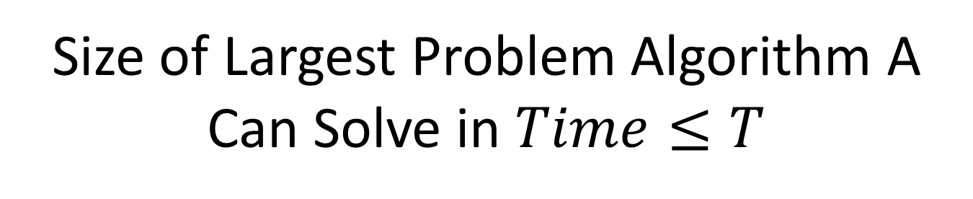
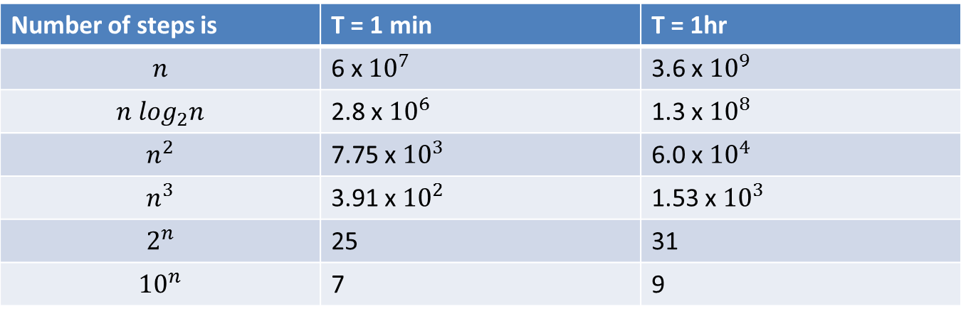
Complexity: Algorithm and Flow Chart, Complexity of Algorithms, Rate of Growth, Big O Notation
Number of steps is | T = 1 min | T = 1hr
 | 25 | 31
 | 7 | 9
Lecture on CSE 1201: Data Structure
@ Mondal, Dept . Of CSE, RUET

Slide 62
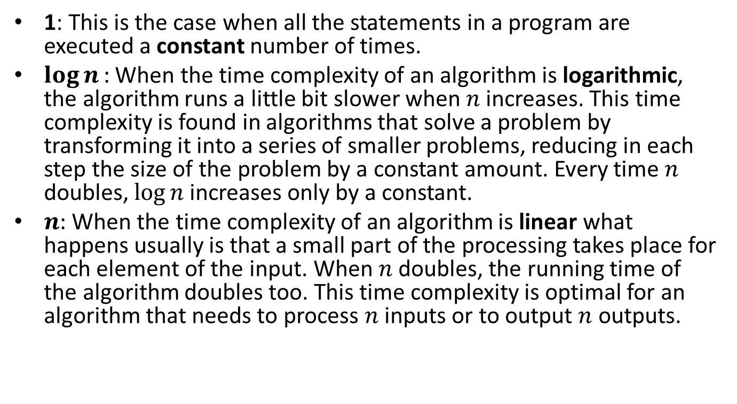
Time Complexity Discussion
Complexity: Algorithm and Flow Chart, Complexity of Algorithms, Rate of Growth, Big O Notation
1: This is the case when all the statements in a program are executed a constant number of times.
$\log{n}:$ When the time complexity of an algorithm is logarithmic, the algorithm runs a little bit slower when $n$ increases. This time complexity is found in algorithms that solve a problem by transforming it into a series of smaller problems, reducing in each step the size of the problem by a constant amount. Every time $n$ doubles, $\log{n}$increases only by a constant.
$n:$When the time complexity of an algorithm is linear what happens usually is that a small part of the processing takes place for each element of the input. When $n$ doubles, the running time of the algorithm doubles too. This time complexity is optimal for an algorithm that needs to process $n$ inputs or to output $n$ outputs.
Lecture on CSE 1201: Data Structure
@ Mondal, Dept . Of CSE, RUET

Slide 63
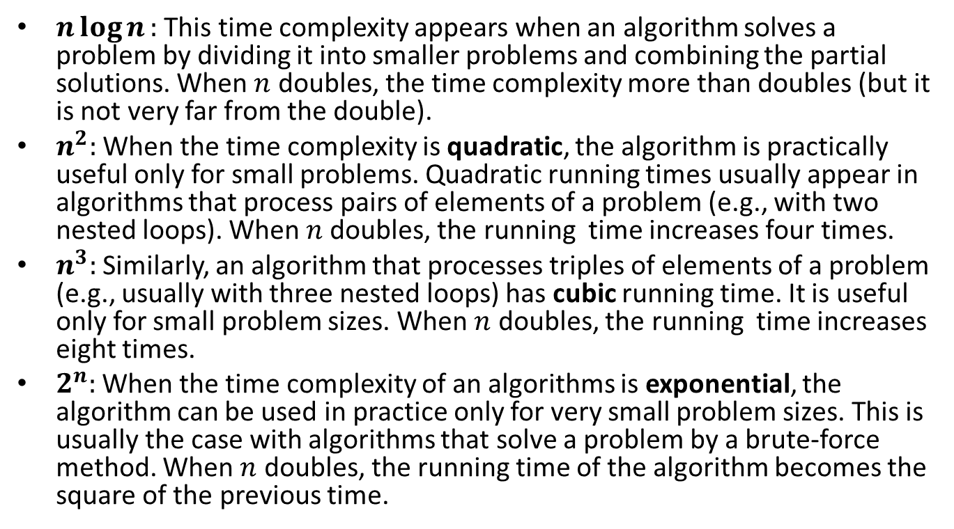
Time Complexity Discussion (cont’d)
Complexity: Algorithm and Flow Chart, Complexity of Algorithms, Rate of Growth, Big O Notation
$n\log{n}:$ This time complexity appears when an algorithm solves a problem by dividing it into smaller problems and combining the partial solutions. When $n$ doubles, the time complexity more than doubles (but it is not very far from the double).
$n^{2}:$ When the time complexity is quadratic, the algorithm is practically useful only for small problems. Quadratic running times usually appear in algorithms that process pairs of elements of a problem (e.g., with two nested loops). When $n$doubles, the running time increases four times.
$n^{3}:$ Similarly, an algorithm that processes triples of elements of a problem (e.g., usually with three nested loops) has cubic running time. It is useful only for small problem sizes. When $n$ doubles, the running time increases eight times.
$2^{n}:$ When the time complexity of an algorithms is exponential, the algorithm can be used in practice only for very small problem sizes. This is usually the case with algorithms that solve a problem by a brute-force method. When $n$ doubles, the running time of the algorithm becomes the square of the previous time.
Lecture on CSE 1201: Data Structure
@ Mondal, Dept . Of CSE, RUET

Slide 64
Time Complexity
Complexity: Algorithm and Flow Chart, Complexity of Algorithms, Rate of Growth, Big O Notation
We have to consider the following cases:
Worst case
Best case
Average case
Lecture on CSE 1201: Data Structure
@ Mondal, Dept . Of CSE, RUET

Slide 65
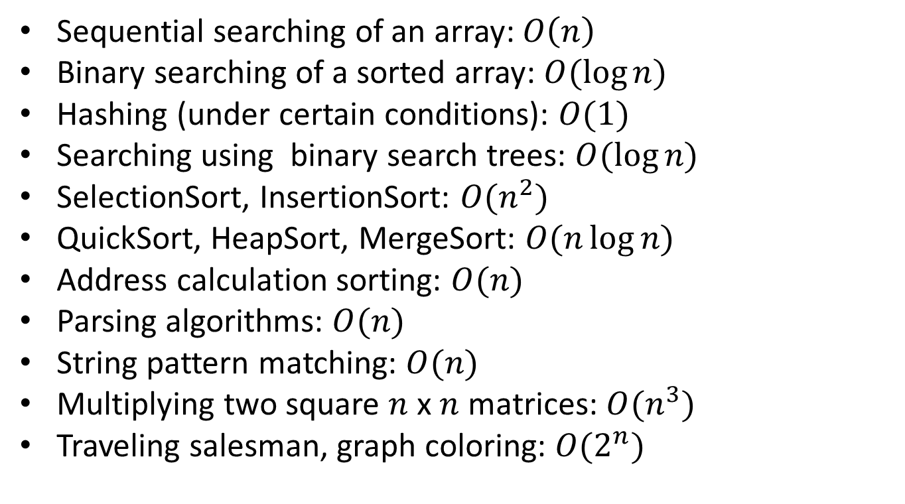
Examples of Well-Known Algorithms and Their Time Complexity
Complexity: Algorithm and Flow Chart, Complexity of Algorithms, Rate of Growth, Big O Notation
Lecture on CSE 1201: Data Structure
@ Mondal, Dept . Of CSE, RUET

Slide 66

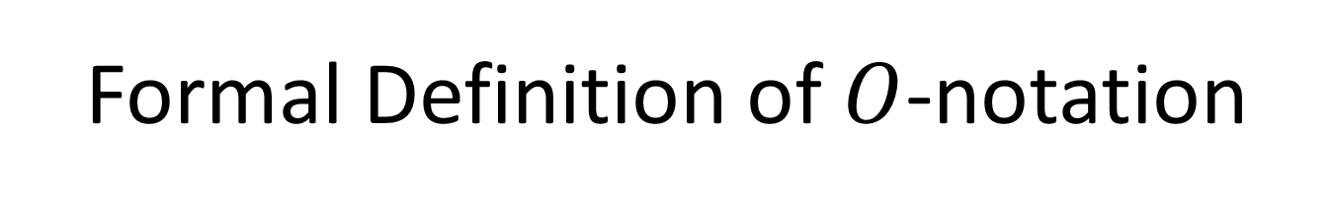
Formal Definition of $O$-notation
Complexity: Algorithm and Flow Chart, Complexity of Algorithms, Rate of Growth, Big O Notation
We say that $f(n)$ is $O(g\left(n\right))$ if there exist two positive constants $K$ and $n_{0}$ such that $|f\left(n\right)|≤K\left|g\left(n\right)\right|$ for all $n≥n_{0}$ .
Lecture on CSE 1201: Data Structure
@ Mondal, Dept . Of CSE, RUET

Slide 67
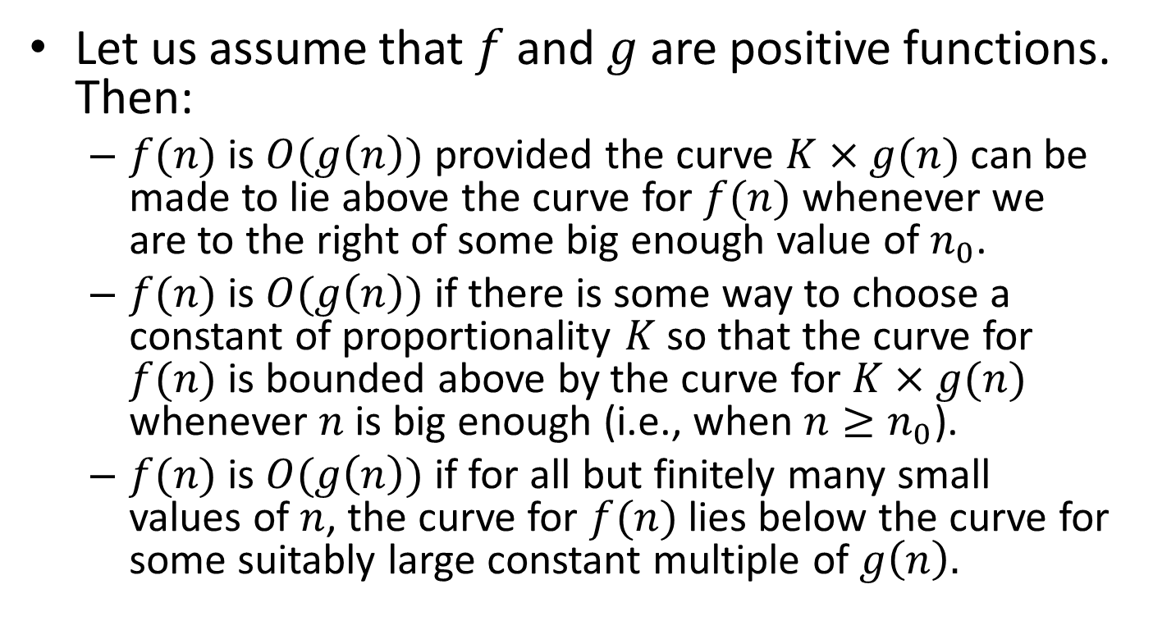
Three Ways of Saying it in Words
Complexity: Algorithm and Flow Chart, Complexity of Algorithms, Rate of Growth, Big O Notation
Let us assume that$f$ and $g$ are positive functions. Then:
$f(n)$ is $O(g\left(n\right))$ provided the curve $K×g(n)$ can be made to lie above the curve for $f(n)$ whenever we are to the right of some big enough value of $n_{0}$.
$f(n)$ is $O(g\left(n\right))$ if there is some way to choose a constant of proportionality $K$ so that the curve for $f(n)$ is bounded above by the curve for $K×g(n)$ whenever $n$ is big enough (i.e., when $n≥n_{0}$).
$f(n)$ is $O(g\left(n\right))$if for all but finitely many small values of $n$, the curve for $f(n)$ lies below the curve for some suitably large constant multiple of $g\left(n\right).$
Lecture on CSE 1201: Data Structure
@ Mondal, Dept . Of CSE, RUET

Slide 68
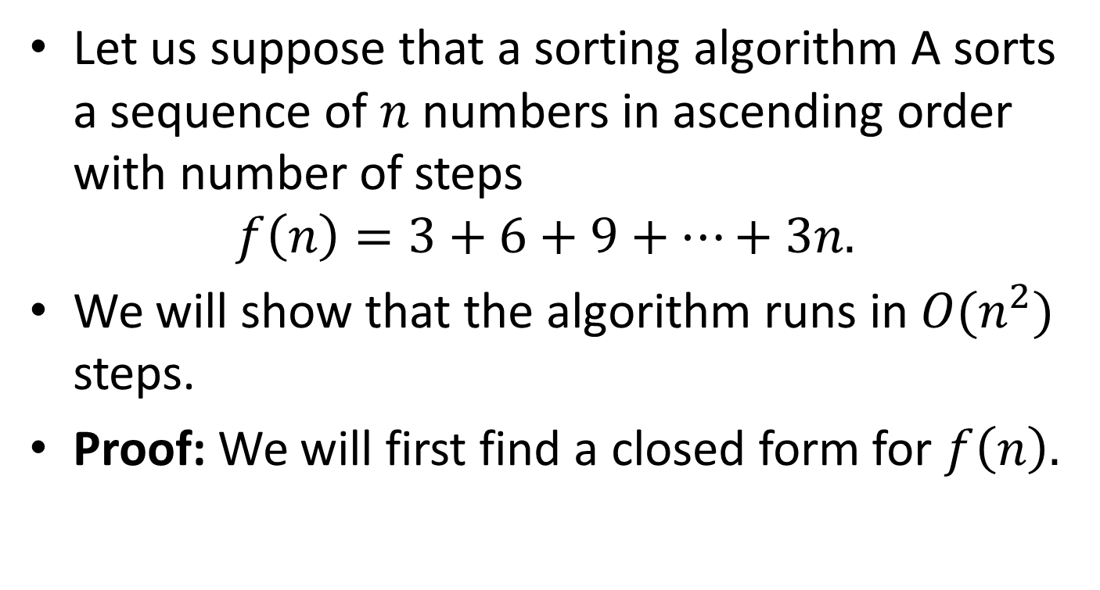
Example of a Formal Proof
Complexity: Algorithm and Flow Chart, Complexity of Algorithms, Rate of Growth, Big O Notation
Let us suppose that a sorting algorithm A sorts a sequence of $n$ numbers in ascending order with number of steps
$$f\left(n\right)=3+6+9+⋯+3n.$$
We will show that the algorithm runs in $O(n^{2})$ steps.
Proof: We will first find a closed form for $f\left(n\right).$
Lecture on CSE 1201: Data Structure
@ Mondal, Dept . Of CSE, RUET

Slide 69
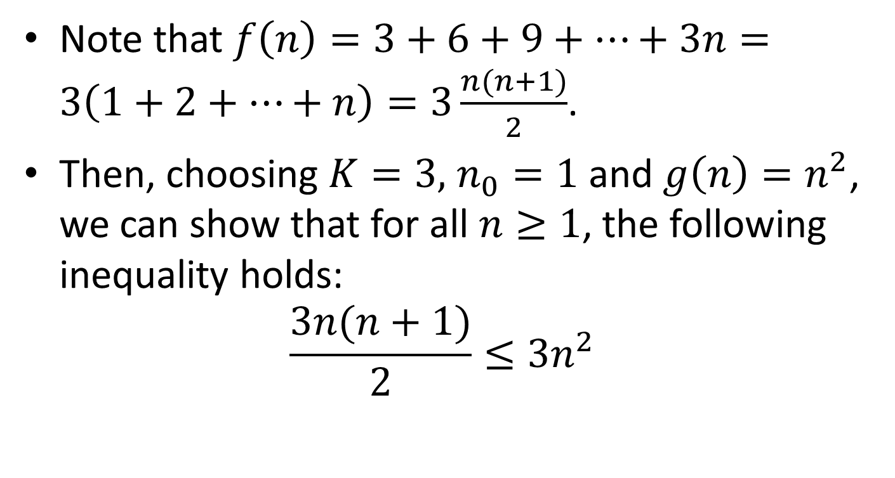
Proof (cont’d)
Complexity: Algorithm and Flow Chart, Complexity of Algorithms, Rate of Growth, Big O Notation
Note that $f\left(n\right)=3+6+9+⋯+3n=3\left(1+2+⋯+n\right)=3\frac{n(n+1)}{2}$.
Then, choosing $K=3,n_{0}=1$ and $g\left(n\right)=n^{2}$, we can show that for all $n≥1$, the following inequality holds:
$$\frac{3n(n+1)}{2}≤3n^{2}$$
Lecture on CSE 1201: Data Structure
@ Mondal, Dept . Of CSE, RUET

Slide 70
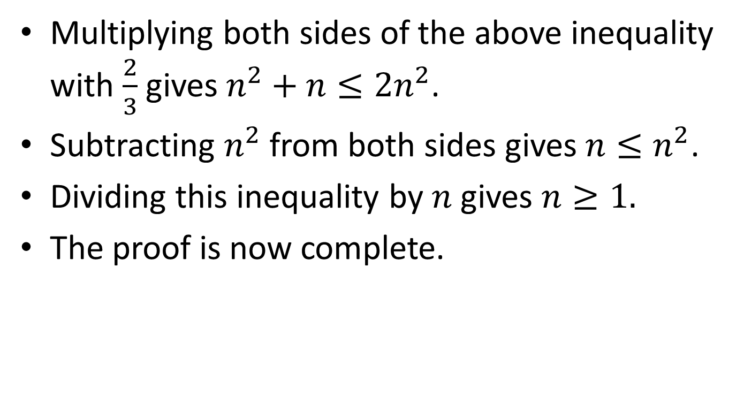
Proof (cont’d)
Complexity: Algorithm and Flow Chart, Complexity of Algorithms, Rate of Growth, Big O Notation
Multiplying both sides of the above inequality with $\frac{2}{3}$ gives $n^{2}+n≤{2n}^{2}$.
Subtracting $n^{2}$ from both sides gives $n≤n^{2}$.
Dividing this inequality by $n$ gives $n≥1.$
The proof is now complete.
Lecture on CSE 1201: Data Structure
@ Mondal, Dept . Of CSE, RUET

Slide 71
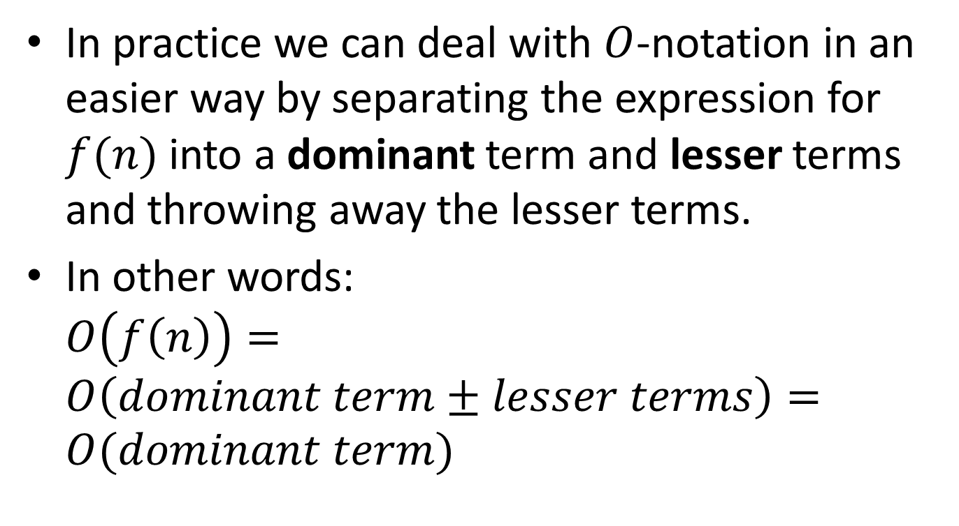
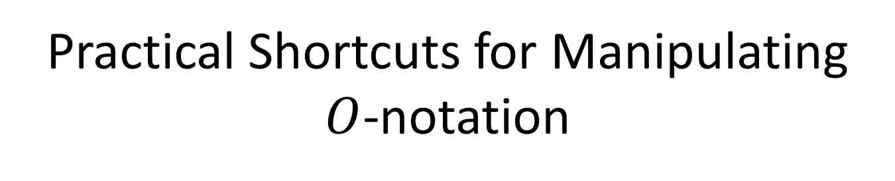
Practical Shortcuts for Manipulating $O$-notation
Complexity: Algorithm and Flow Chart, Complexity of Algorithms, Rate of Growth, Big O Notation
In practice we can deal with $O$-notation in an easier way by separating the expression for $f(n)$into a dominant term and lesser terms and throwing away the lesser terms.
In other words: $O\left(f\left(n\right)\right)=O\left(dominant term±lesser terms\right)=O(dominant term)$
Lecture on CSE 1201: Data Structure
@ Mondal, Dept . Of CSE, RUET

Slide 72
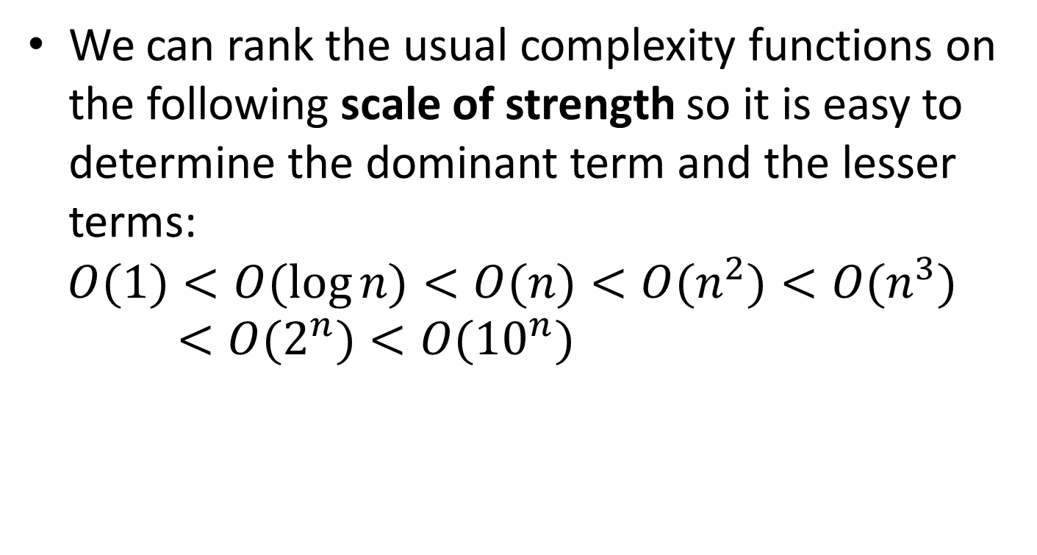

Scale of Strength for $O$-notation
Complexity: Algorithm and Flow Chart, Complexity of Algorithms, Rate of Growth, Big O Notation
We can rank the usual complexity functions on the following scale of strength so it is easy to determine the dominant term and the lesser terms:
$$O(1)<O(\log{n})<O(n)<O(n^{2})<O(n^{3})<O(2^{n})<O({10}^{n})$$
Lecture on CSE 1201: Data Structure
@ Mondal, Dept . Of CSE, RUET

Slide 73
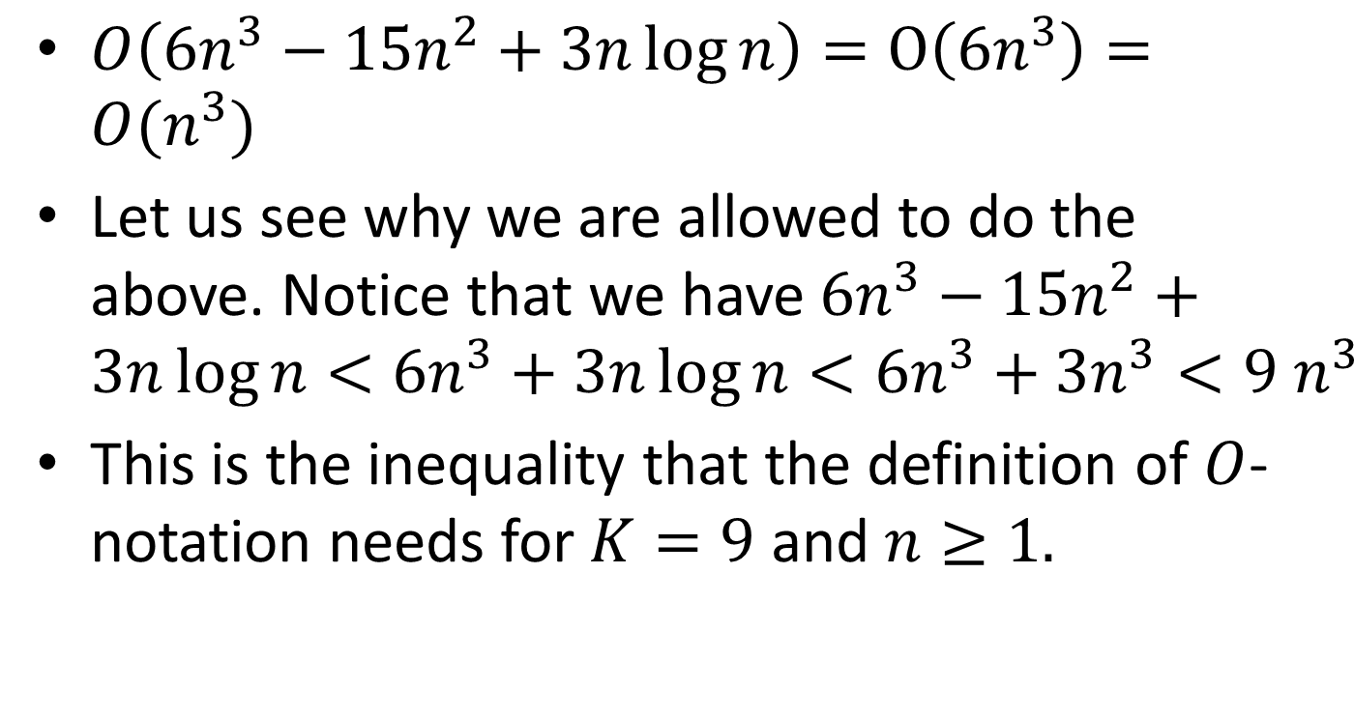
Example
Complexity: Algorithm and Flow Chart, Complexity of Algorithms, Rate of Growth, Big O Notation
$O\left(6n^{3}−15n^{2}+3n\log{n}\right)=O\left(6n^{3}\right)=O(n^{3})$
Let us see why we are allowed to do the above. Notice that we have $6n^{3}−15n^{2}+3n\log{n<6n^{3}+3n\log{n}<6n^{3}+3n^{3}<9{ n}^{3}}$
This is the inequality that the definition of $O$-notation needs for $K=9$ and $n≥1.$
Lecture on CSE 1201: Data Structure
@ Mondal, Dept . Of CSE, RUET

Slide 74
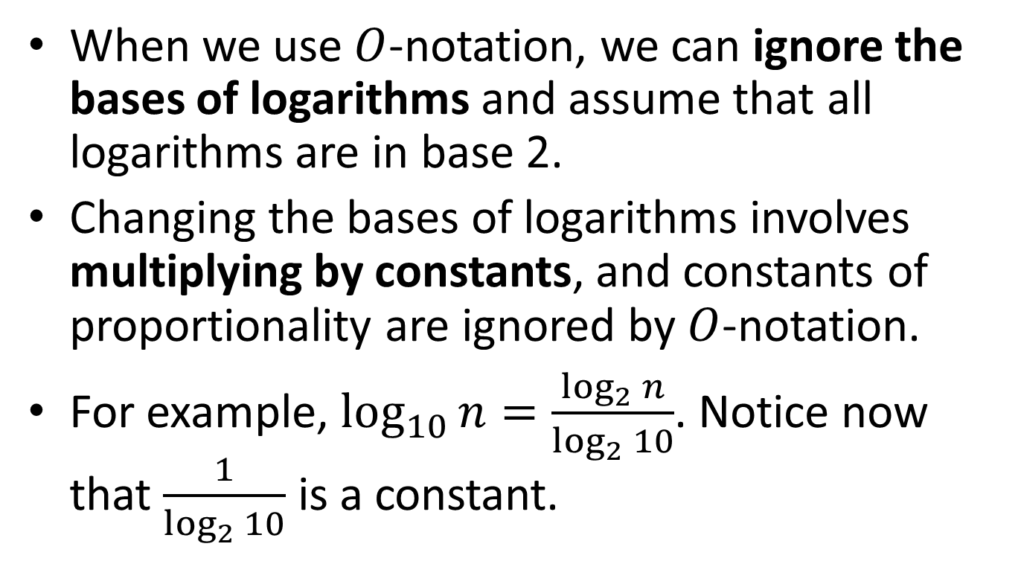
Ignoring Bases of Logarithms
Complexity: Algorithm and Flow Chart, Complexity of Algorithms, Rate of Growth, Big O Notation
When we use $O$-notation, we can ignore the bases of logarithms and assume that all logarithms are in base 2.
Changing the bases of logarithms involves multiplying by constants, and constants of proportionality are ignored by $O$-notation.
For example, $\log_{10}{n=\frac{\log_{2}{n}}{\log_{2}{10}}}$. Notice now that $\frac{1}{\log_{2}{10}}$ is a constant.
Lecture on CSE 1201: Data Structure
@ Mondal, Dept . Of CSE, RUET

Slide 75
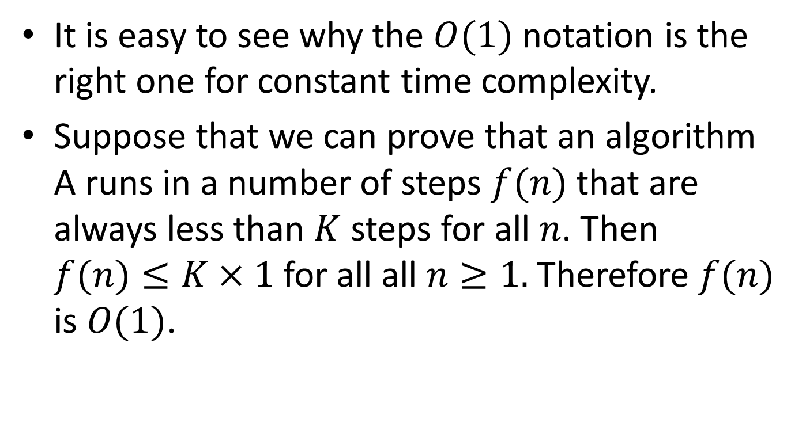

$$O(1)$$
Complexity: Algorithm and Flow Chart, Complexity of Algorithms, Rate of Growth, Big O Notation
It is easy to see why the $O(1)$ notation is the right one for constant time complexity.
Suppose that we can prove that an algorithm A runs in a number of steps $f(n)$ that are always less than $K$ steps for all $n$. Then $f(n)≤K×1$for all all$n≥1.$ Therefore $f(n)$ is $O(1)$.
Lecture on CSE 1201: Data Structure
@ Mondal, Dept . Of CSE, RUET

Slide 76
Some Algorithms and Their Complexity
Complexity: Algorithm and Flow Chart, Complexity of Algorithms, Rate of Growth, Big O Notation
Sequential searching
Selection sort
Recursive selection sort
Towers of Hanoi
Lecture on CSE 1201: Data Structure
@ Mondal, Dept . Of CSE, RUET

Slide 77
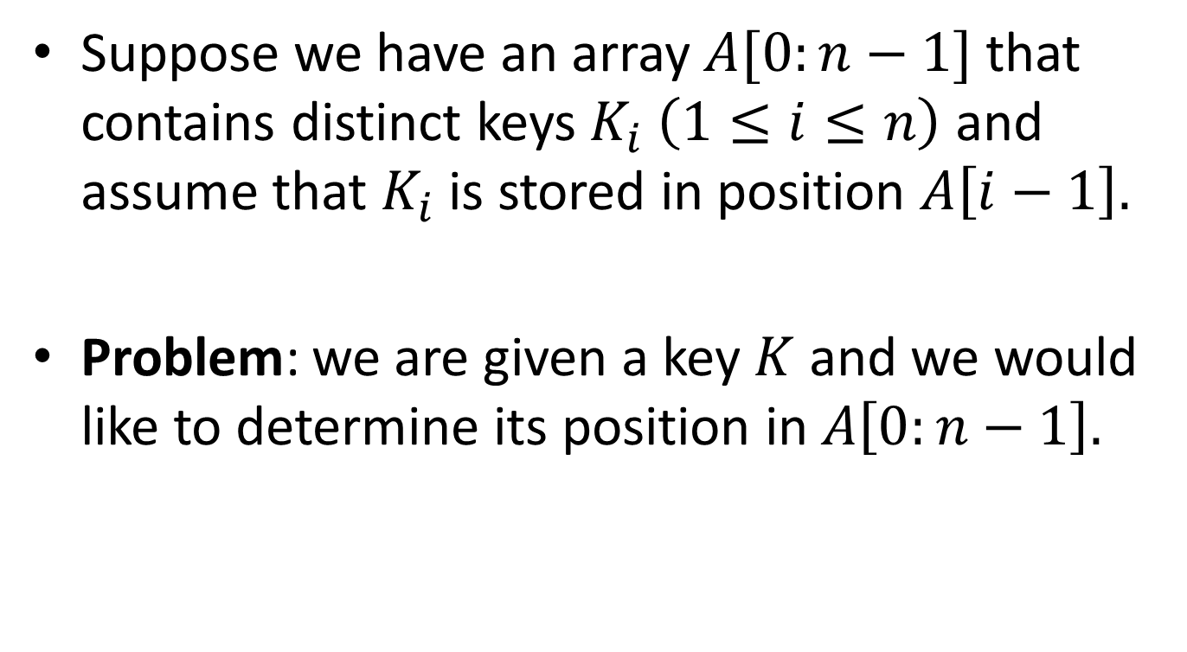
Analysis of Sequential Searching
Complexity: Algorithm and Flow Chart, Complexity of Algorithms, Rate of Growth, Big O Notation
Suppose we have an array $A[0:n−1]$ that contains distinct keys $K_{i}\left(1≤i≤n\right)$ and assume that $K_{i}$ is stored in position $A\left[i−1\right].$
Problem: we are given a key $K$ and we would like to determine its position in $A\left[0:n−1\right].$
Lecture on CSE 1201: Data Structure
@ Mondal, Dept . Of CSE, RUET

Slide 78
An Algorithm for Sequential Searching
Complexity: Algorithm and Flow Chart, Complexity of Algorithms, Rate of Growth, Big O Notation
#define n 100
typedef int Key;
typedef Key SearchArray[n];
int SequentialSearch(Key K, SearchArray A)
{
int i;
for (i=0; i<n; ++i){
if (K==A[i]) return i;
}
return(-1);
}
Lecture on CSE 1201: Data Structure
@ Mondal, Dept . Of CSE, RUET

Slide 79
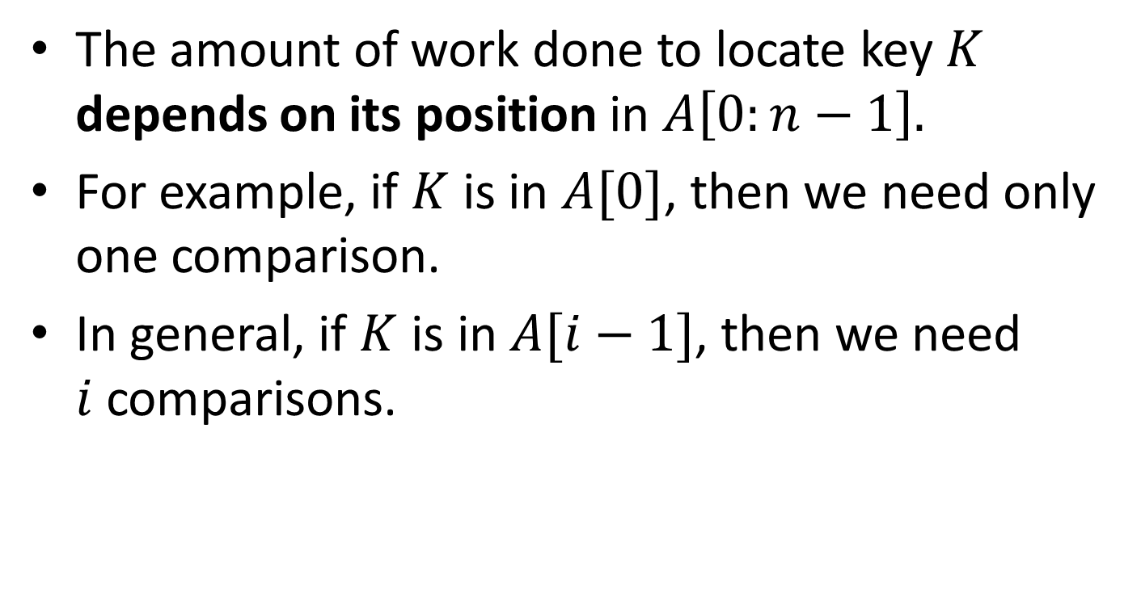
Complexity Analysis
Complexity: Algorithm and Flow Chart, Complexity of Algorithms, Rate of Growth, Big O Notation
The amount of work done to locate key $K$depends on its position in $A\left[0:n−1\right].$
For example, if $K$ is in $A[0]$, then we need only one comparison.
In general, if $K$ is in $A[i−1]$, then we need $i$comparisons.
Lecture on CSE 1201: Data Structure
@ Mondal, Dept . Of CSE, RUET

Slide 80
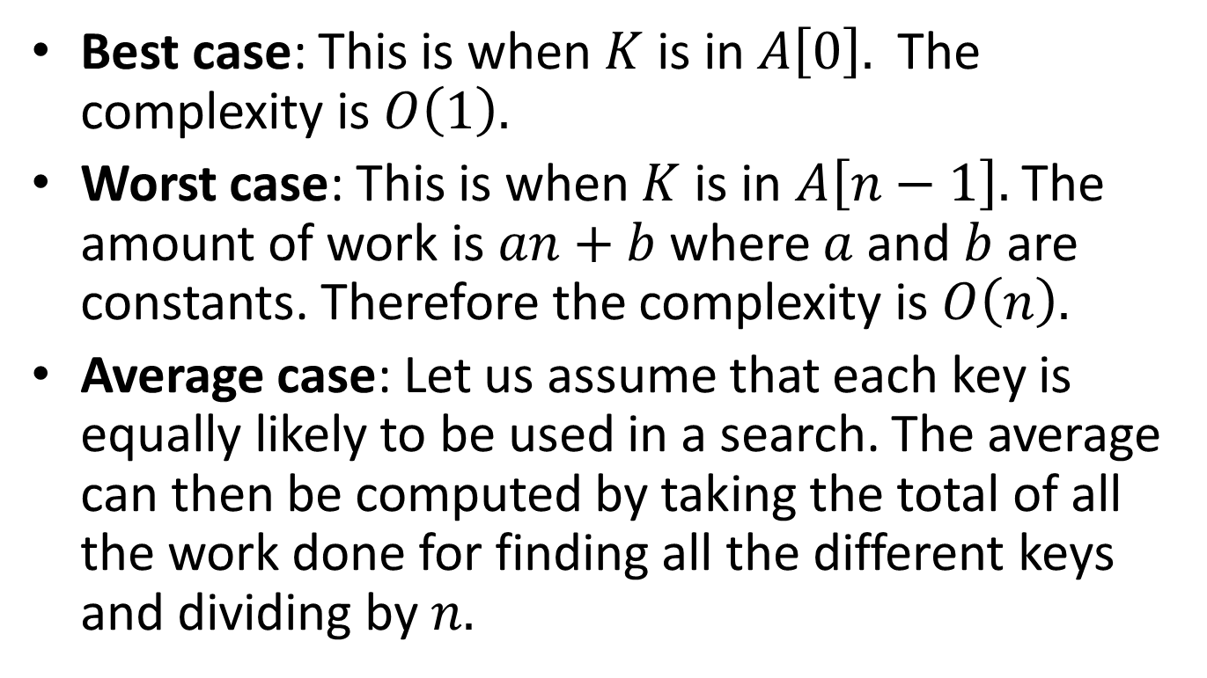
Complexity Analysis (cont’d)
Complexity: Algorithm and Flow Chart, Complexity of Algorithms, Rate of Growth, Big O Notation
Best case: This is when $K$ is in $A\left[0\right].$ The complexity is $O\left(1\right).$
Worst case: This is when $K$ is in $A\left[n−1\right].$ The amount of work is $an+b$where $a$ and $b$ are constants. Therefore the complexity is $O\left(n\right).$
Average case: Let us assume that each key is equally likely to be used in a search. The average can then be computed by taking the total of all the work done for finding all the different keys and dividing by $n.$
Lecture on CSE 1201: Data Structure
@ Mondal, Dept . Of CSE, RUET

Slide 81
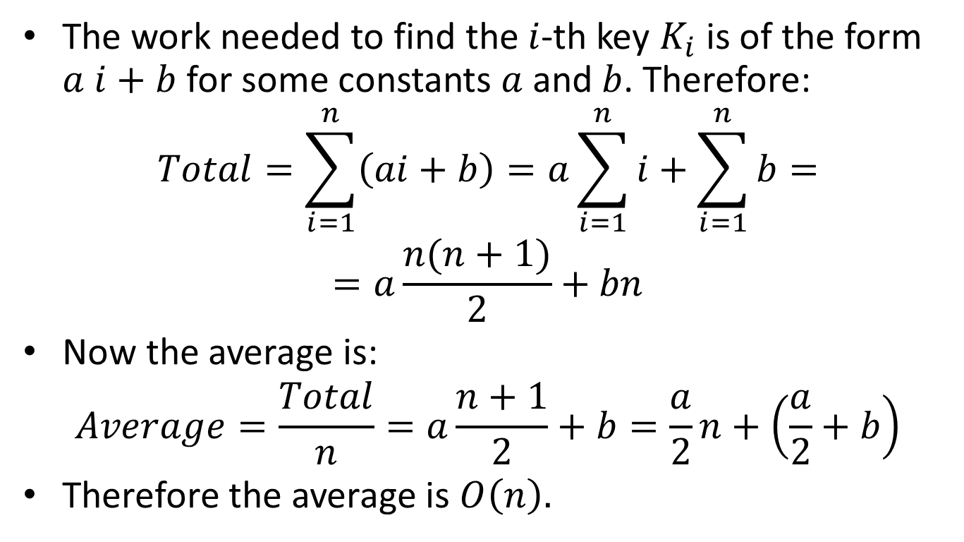
Complexity Analysis (cont’d)
Complexity: Algorithm and Flow Chart, Complexity of Algorithms, Rate of Growth, Big O Notation
The work needed to find the $i$-th key $K_{i}$ is of the form $a i+b$ for some constants $a$and $b$. Therefore:
$$Total=\sum_{i=1}^{n}{\left(ai+b\right)=a\sum_{i=1}^{n}{i}}+\sum_{i=1}^{n}{b=}$$
$$=a\frac{n(n+1)}{2}+bn$$
Now the average is:
$$Average=\frac{Total}{n}=a\frac{n+1}{2}+b=\frac{a}{2}n+\left(\frac{a}{2}+b\right)$$
Therefore the average is $O\left(n\right).$
Lecture on CSE 1201: Data Structure
@ Mondal, Dept . Of CSE, RUET

Slide 82
Selection Sorting Algorithm
Complexity: Algorithm and Flow Chart, Complexity of Algorithms, Rate of Growth, Big O Notation
void SelectionSort(InputArray A)
{
int MinPosition, temp, i, j;
for (i=n-1; i>0; --i){
MinPosition=i;
for (j=0; j<i; ++i){
if (A[j] < A[MinPosition]){
MinPosition=j;
}
}
temp=A[i];
A[i]=A[MinPosition];
A[MinPosition]=temp;
}
}
Lecture on CSE 1201: Data Structure
@ Mondal, Dept . Of CSE, RUET

Slide 83
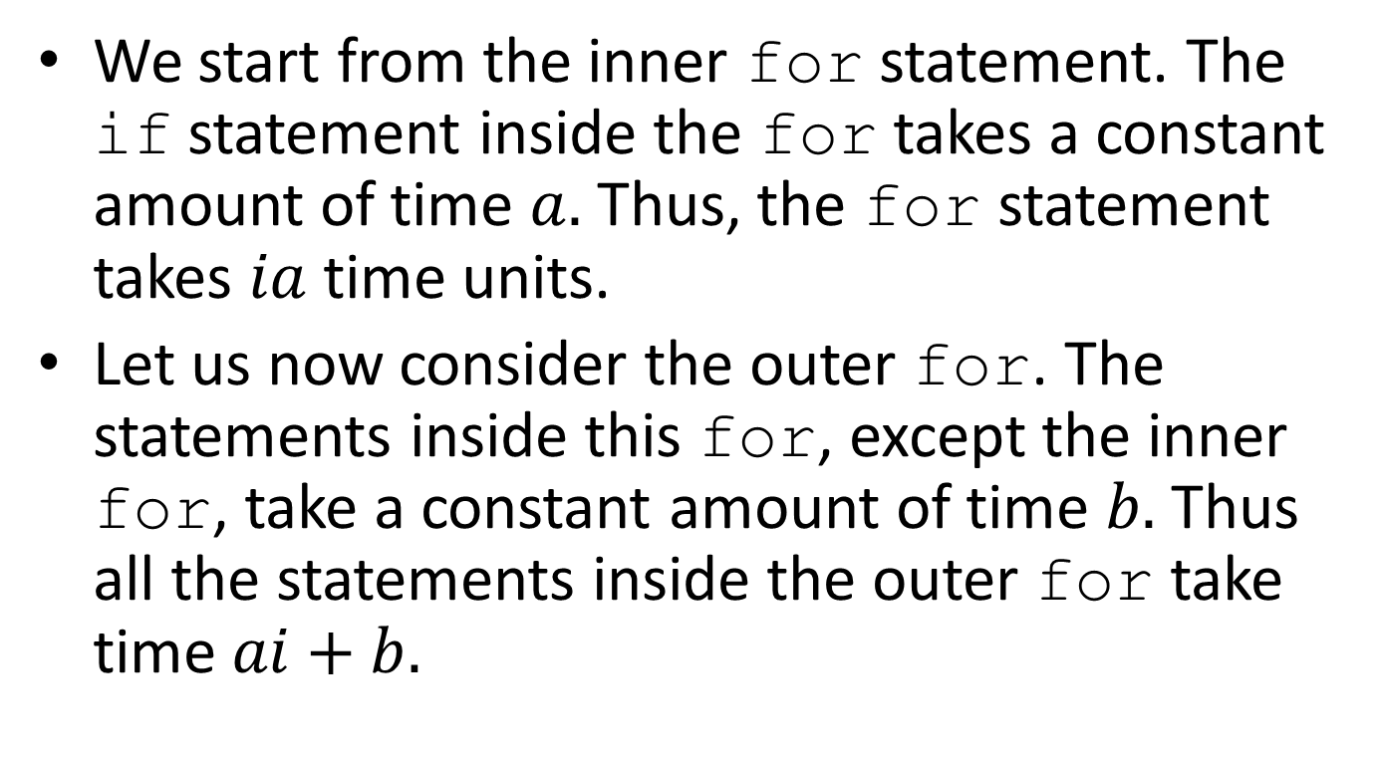
Complexity Analysis of SelectionSort
Complexity: Algorithm and Flow Chart, Complexity of Algorithms, Rate of Growth, Big O Notation
We start from the inner for statement. The if statement inside the for takes a constant amount of time $a.$ Thus, the for statement takes $ia$ time units.
Let us now consider the outer for. The statements inside this for, except the inner for, take a constant amount of time $b.$ Thus all the statements inside the outer for take time $ai+b.$
Lecture on CSE 1201: Data Structure
@ Mondal, Dept . Of CSE, RUET

Slide 84
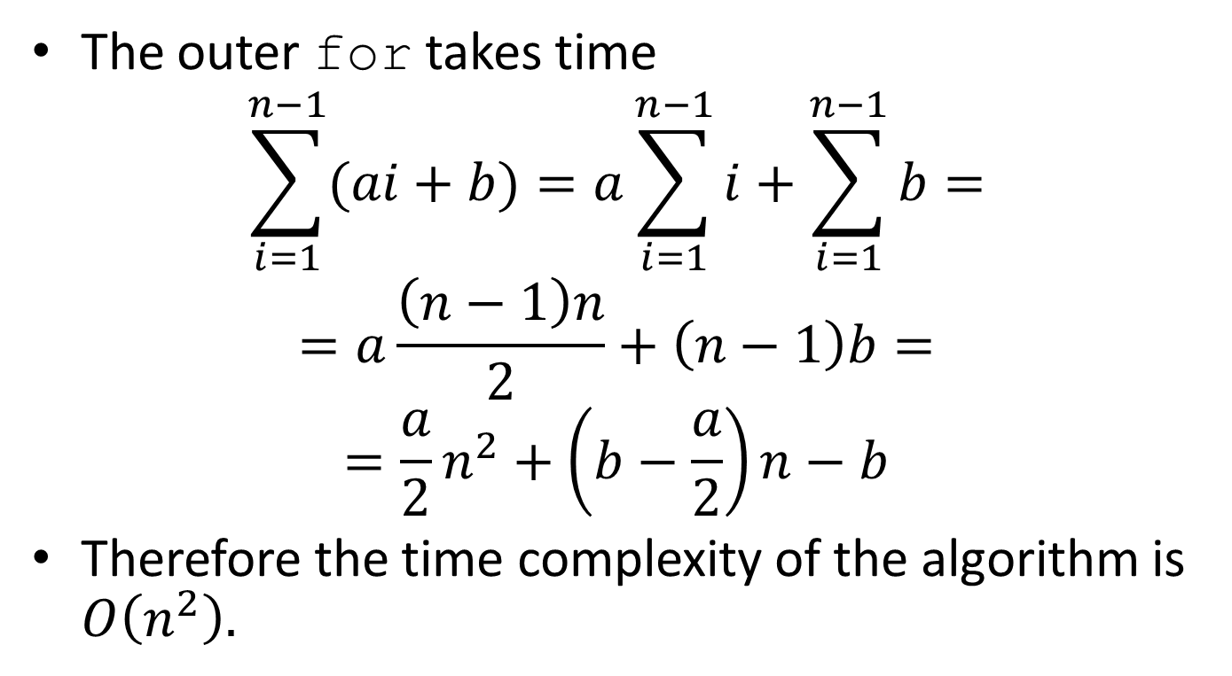
Complexity Analysis (cont’d)
Complexity: Algorithm and Flow Chart, Complexity of Algorithms, Rate of Growth, Big O Notation
The outer for takes time
$$\sum_{i=1}^{n−1}{(ai+b)=a\sum_{i=1}^{n−1}{i+\sum_{i=1}^{n−1}{b=}}}$$
$$=a\frac{\left(n−1\right)n}{2}+\left(n−1\right)b=$$
$$=\frac{a}{2}n^{2}+\left(b−\frac{a}{2}\right)n−b$$
Therefore the time complexity of the algorithm is $O\left(n^{2}\right).$
Lecture on CSE 1201: Data Structure
@ Mondal, Dept . Of CSE, RUET

Slide 85
Recursive SelectionSort
Complexity: Algorithm and Flow Chart, Complexity of Algorithms, Rate of Growth, Big O Notation
/* FindMin is an auxiliary function used by the Selection sort below */
int FindMin(InputArray A, int n)
{
int i,j=n;
for (i=0; i<n; ++i) if (A[i]<A[j]) j=i;
return j;
}
void SelectionSort(InputArray A, int n)
{
int MinPosition, temp;
if (n>0){
MinPosition=FindMin(A,n);
temp=A[n]; A[n]=A[MinPosition]; A[MinPosition]=temp;
SelectionSort(A, n-1)
}
}
Lecture on CSE 1201: Data Structure
@ Mondal, Dept . Of CSE, RUET

Slide 86
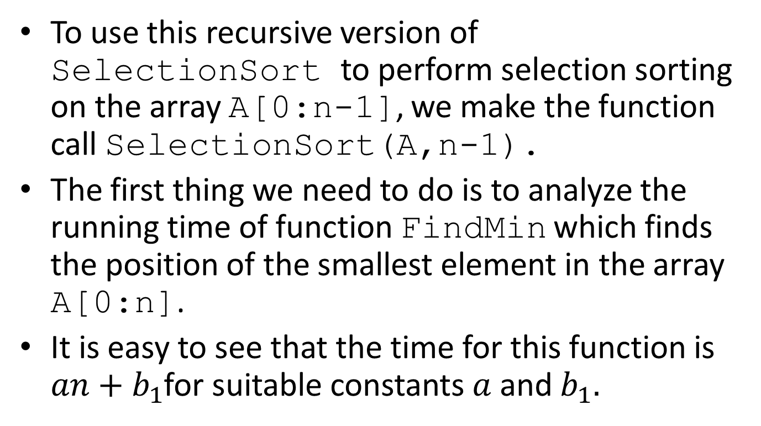
Analysis of Recursive SelectionSort
Complexity: Algorithm and Flow Chart, Complexity of Algorithms, Rate of Growth, Big O Notation
To use this recursive version of SelectionSortto perform selection sorting on the array A[0:n-1], we make the function call SelectionSort(A,n-1).
The first thing we need to do is to analyze the running time of function FindMinwhich finds the position of the smallest element in the array A[0:n].
It is easy to see that the time for this function is $an+b_{1}$for suitable constants $a$ and $b_{1}.$
Lecture on CSE 1201: Data Structure
@ Mondal, Dept . Of CSE, RUET

Slide 87
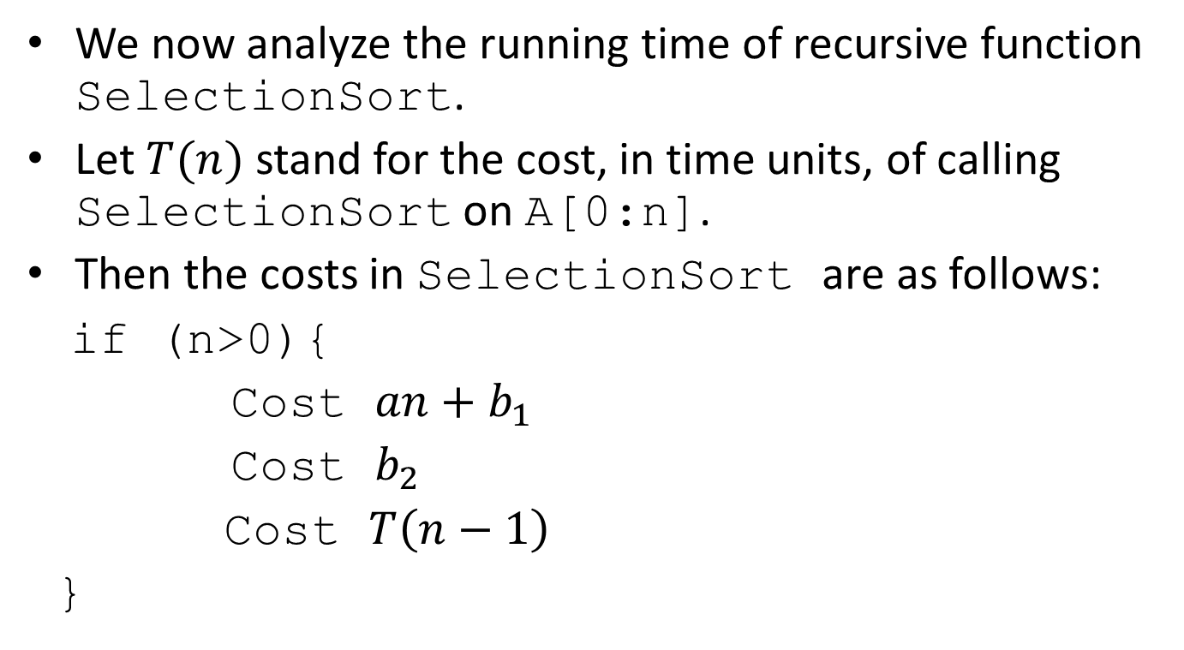
Analysis of Recursive SelectionSort (cont’d)
Complexity: Algorithm and Flow Chart, Complexity of Algorithms, Rate of Growth, Big O Notation
We now analyze the running time of recursive function SelectionSort.
Let $T(n)$ stand for the cost, in time units, of calling SelectionSort on A[0:n].
Then the costs in SelectionSortare as follows:
if (n>0){
Cost $an+b_{1}$
Cost $b_{2}$
Cost $T\left(n−1\right)$
}
Lecture on CSE 1201: Data Structure
@ Mondal, Dept . Of CSE, RUET

Slide 88
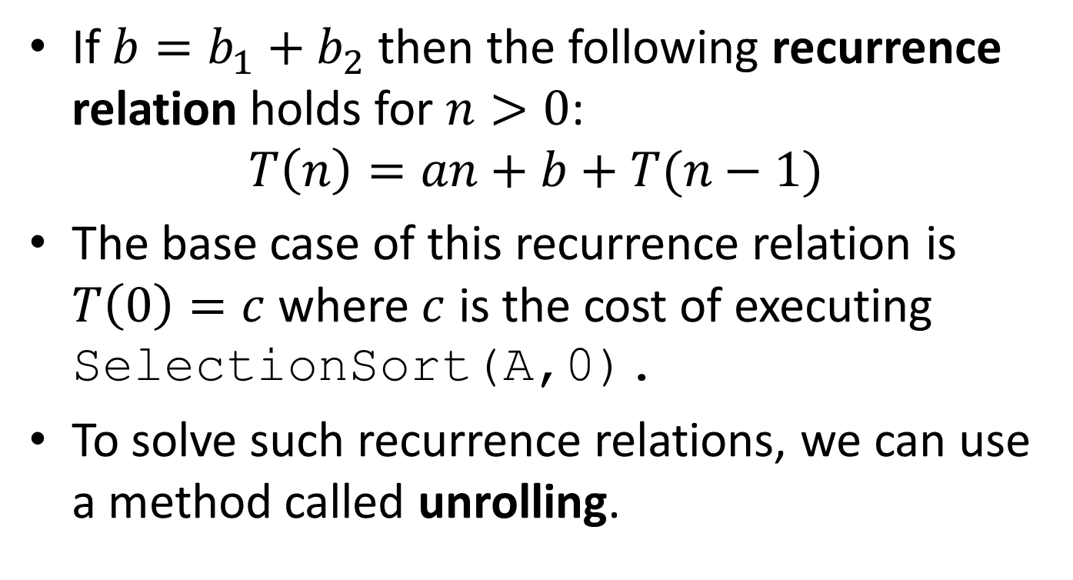
Analysis of Recursive SelectionSort (cont’d)
Complexity: Algorithm and Flow Chart, Complexity of Algorithms, Rate of Growth, Big O Notation
If $b=b_{1}+b_{2}$ then the following recurrence relation holds for $n>0$:
$$T\left(n\right)=an+b+T(n−1)$$
The base case of this recurrence relation is $T\left(0\right)=c$ where $c$ is the cost of executing SelectionSort(A,0).
To solve such recurrence relations, we can use a method called unrolling.
Lecture on CSE 1201: Data Structure
@ Mondal, Dept . Of CSE, RUET

Slide 89
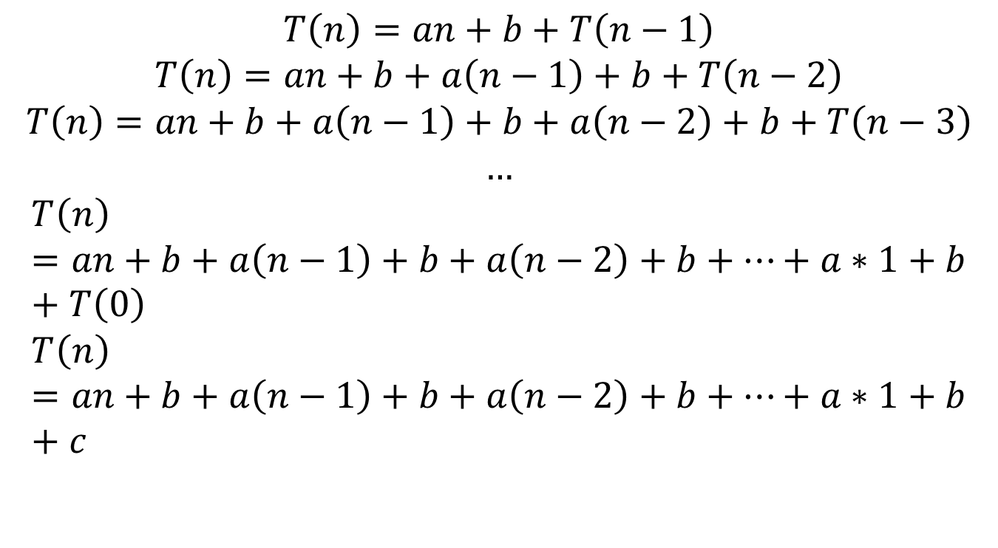
Analysis of Recursive SelectionSort (cont’d)
Complexity: Algorithm and Flow Chart, Complexity of Algorithms, Rate of Growth, Big O Notation
$$T\left(n\right)=an+b+T\left(n−1\right)$$
$$T\left(n\right)=an+b+a\left(n−1\right)+b+T\left(n−2\right)$$
$$T\left(n\right)=an+b+a\left(n−1\right)+b+a\left(n−2\right)+b+T\left(n−3\right)$$
$$…$$
$$T\left(n\right)=an+b+a\left(n−1\right)+b+a\left(n−2\right)+b+⋯+a∗1+b+T\left(0\right)$$
$$T\left(n\right)=an+b+a\left(n−1\right)+b+a\left(n−2\right)+b+⋯+a∗1+b+c$$
Lecture on CSE 1201: Data Structure
@ Mondal, Dept . Of CSE, RUET

Slide 90
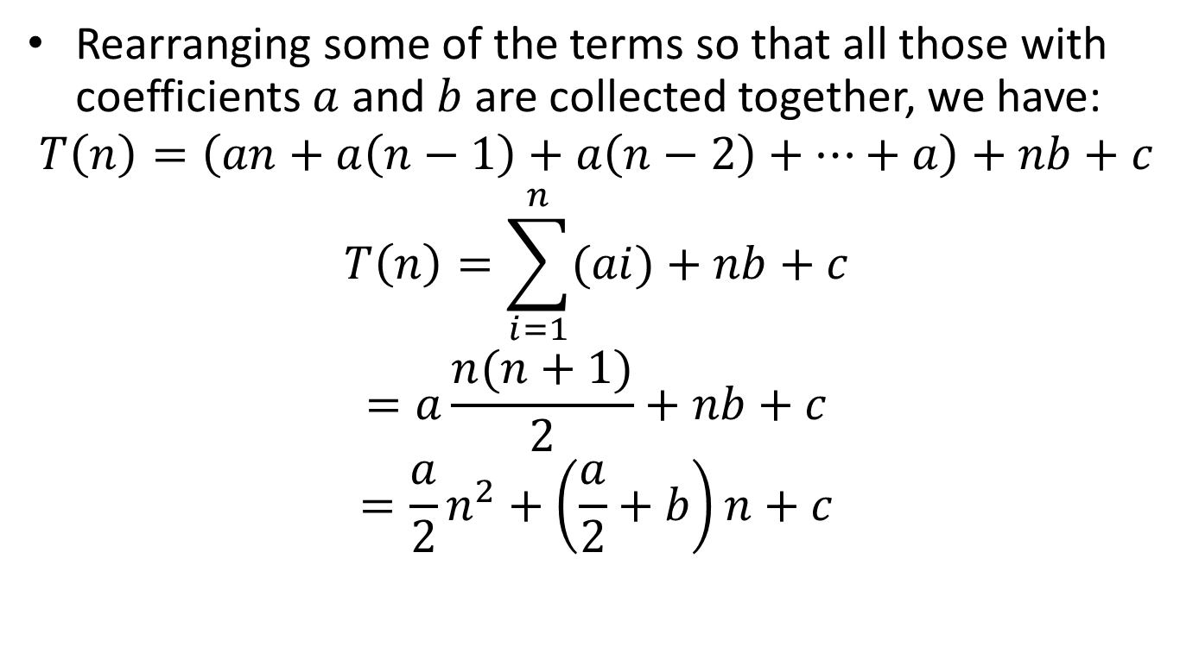
Analysis of Recursive SelectionSort (cont’d)
Complexity: Algorithm and Flow Chart, Complexity of Algorithms, Rate of Growth, Big O Notation
Rearranging some of the terms so that all those with coefficients $a$ and $b$ are collected together, we have:
$$T\left(n\right)=\left(an+a\left(n−1\right)+a\left(n−2\right)+⋯+a\right)+nb+c$$
$$T\left(n\right)=\sum_{i=1}^{n}{(ai)}+nb+c$$
$$=a\frac{n(n+1)}{2}+nb+c$$
$$=\frac{a}{2}n^{2}+\left(\frac{a}{2}+b\right)n+c$$
Lecture on CSE 1201: Data Structure
@ Mondal, Dept . Of CSE, RUET

Slide 91

Analysis of Recursive SelectionSort (cont’d)
Complexity: Algorithm and Flow Chart, Complexity of Algorithms, Rate of Growth, Big O Notation
Therefore $T(n)$ but also $T(n−1)$ is $O\left(n^{2}\right).$
Lecture on CSE 1201: Data Structure
@ Mondal, Dept . Of CSE, RUET

Slide 92
A Recursive Solution to the Towers of Hanoi
Complexity: Algorithm and Flow Chart, Complexity of Algorithms, Rate of Growth, Big O Notation
void MoveTowers(int n, int start, int finish, int spare)
{
if (n==1){
printf(“Move a disk from peg %1d to peg %1d\n”, start, finish);
} else {
MoveTowers(n-1, start, spare, finish);
printf(“Move a disk from peg %1d to peg %1d\n”, start, finish);
MoveTowers(n-1, spare, finish, start);
}
}
Lecture on CSE 1201: Data Structure
@ Mondal, Dept . Of CSE, RUET

Slide 93
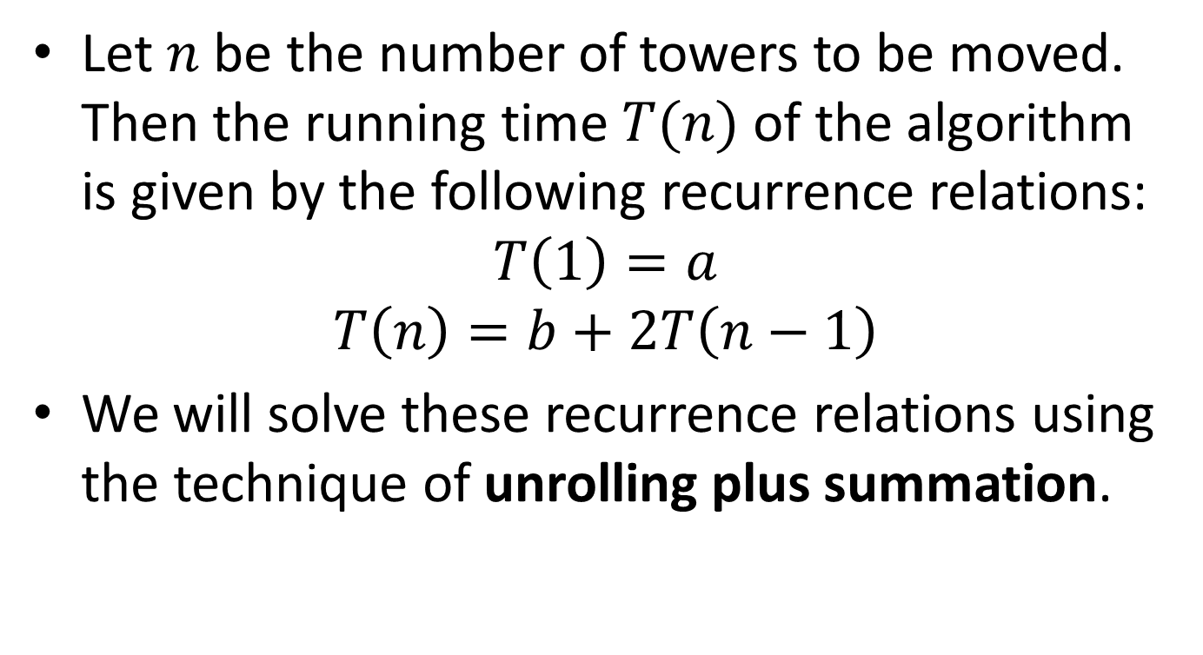
Analysis of Towers of Hanoi
Complexity: Algorithm and Flow Chart, Complexity of Algorithms, Rate of Growth, Big O Notation
Let $n$ be the number of towers to be moved. Then the running time $T(n)$ of the algorithm is given by the following recurrence relations:
$$T\left(1\right)=a$$
$$T\left(n\right)=b+2T\left(n−1\right)$$
We will solve these recurrence relations using the technique of unrolling plus summation.
Lecture on CSE 1201: Data Structure
@ Mondal, Dept . Of CSE, RUET

Slide 94
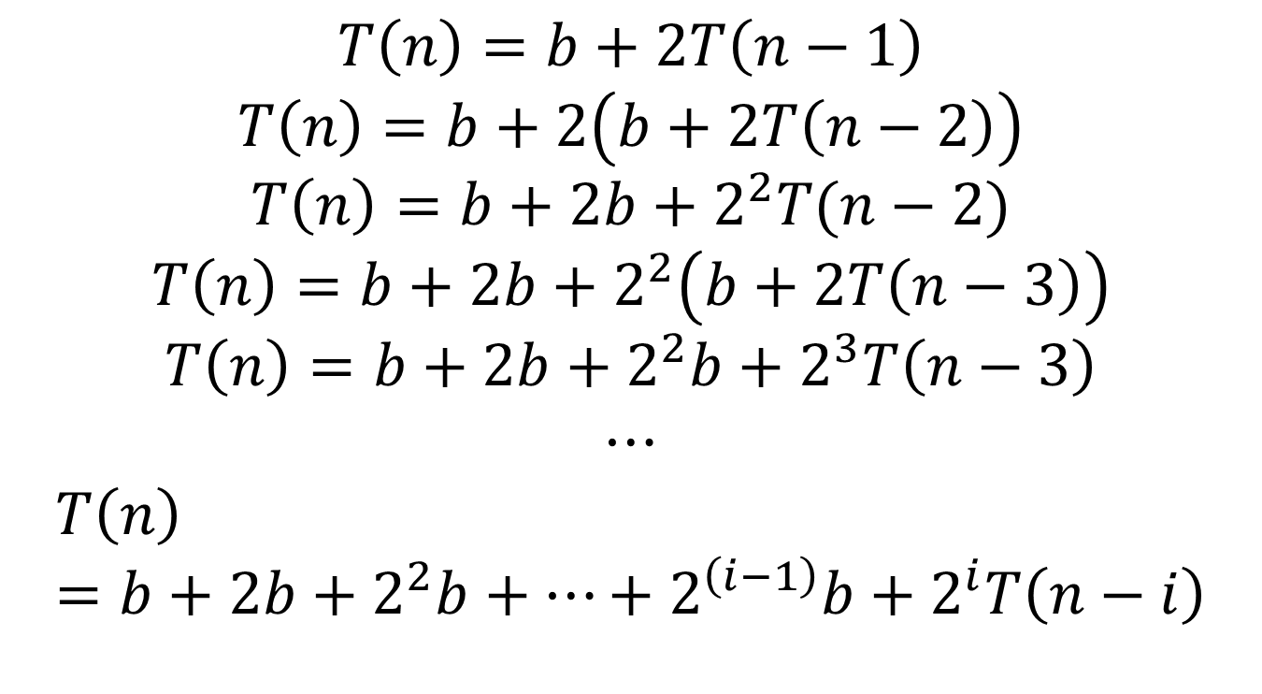
Analysis of Towers of Hanoi (cont’d)
$$T\left(n\right)=b+2T\left(n−1\right)$$
$$T\left(n\right)=b+2\left(b+2T\left(n−2\right)\right)$$
$$T\left(n\right)=b+2b+2^{2}T(n−2)$$
$$T\left(n\right)=b+2b+2^{2}\left(b+2T\left(n−3\right)\right)$$
$$T\left(n\right)=b+2b+2^{2}b+2^{3}T\left(n−3\right)$$
$$⋯$$
$$T\left(n\right)=b+2b+2^{2}b+…+2^{\left(i−1\right)}b+2^{i}T\left(n−i\right)$$

Slide 95
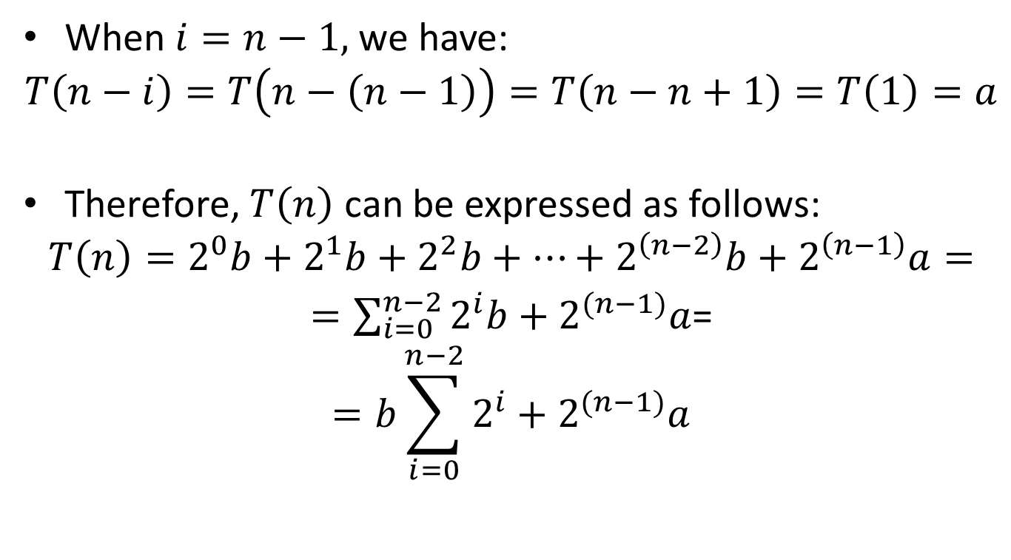
Analysis of Towers of Hanoi (cont’d)
When $i=n−1,$we have:
$$T\left(n−i\right)=T\left(n−\left(n−1\right)\right)=T\left(n−n+1\right)=T\left(1\right)=a$$
Therefore, $T\left(n\right)$ can be expressed as follows:
$$T\left(n\right)=2^{0}b+2^{1}b+2^{2}b+…+2^{\left(n−2\right)}b+2^{\left(n−1\right)}a=$$
$=\sum_{i=0}^{n−2}{2^{i}b+2^{(n−1)}a}$=
$$=b\sum_{i=0}^{n−2}{2^{i}}+2^{(n−1)}a$$

Slide 96
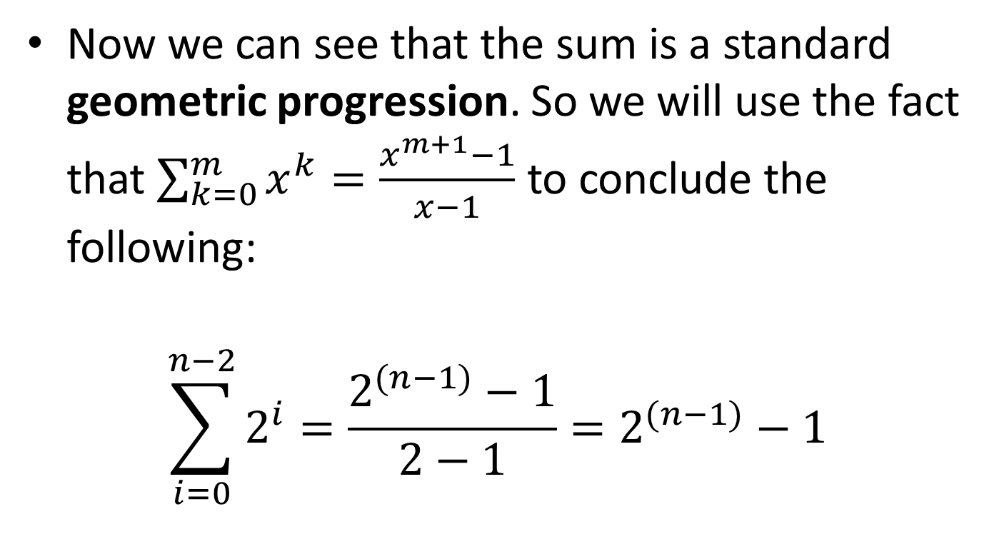
Analysis of Towers of Hanoi (cont’d)
Now we can see that the sum is a standard geometric progression. So we will use the fact that $\sum_{k=0}^{m}{x^{k}}=\frac{x^{m+1}−1}{x−1}$ to conclude the following:
$$\sum_{i=0}^{n−2}{2^{i}}=\frac{2^{(n−1)}−1}{2−1}=2^{(n−1)}−1$$

Slide 97
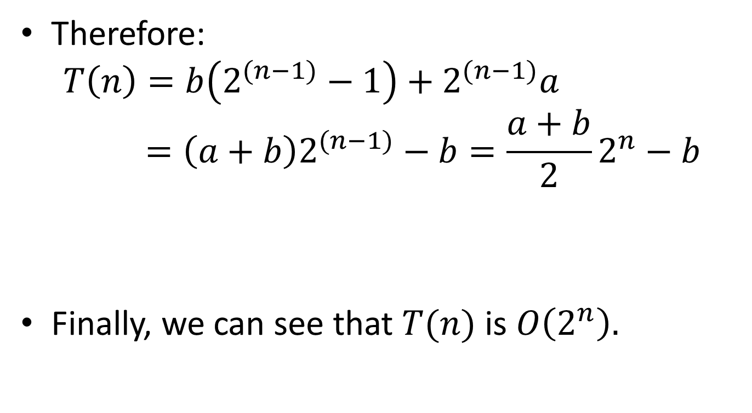
Analysis of Towers of Hanoi (cont’d)
Therefore:
$$T\left(n\right)=b\left(2^{(n−1)}−1\right)+2^{(n−1)}a=\left(a+b\right)2^{(n−1)}−b=\frac{a+b}{2}2^{n}−b$$
Finally, we can see that $T(n)$ is $O\left(2^{n}\right).$

Slide 98
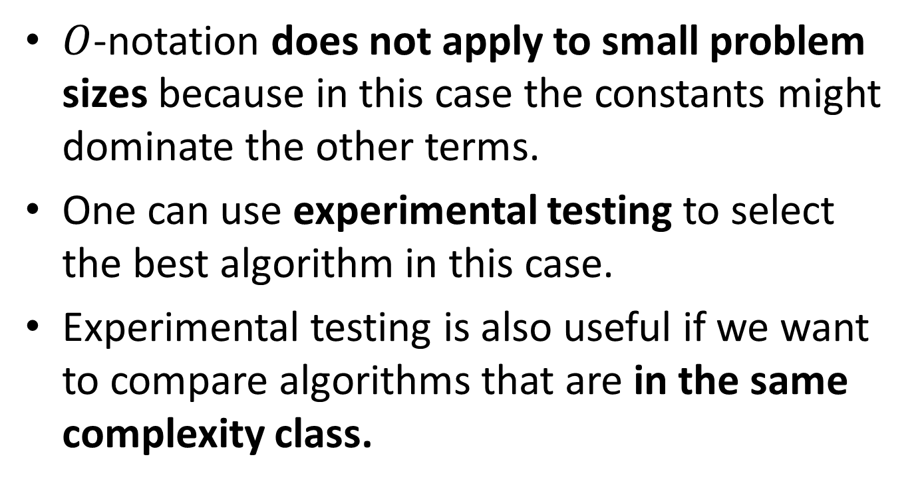

What $O$-notation Does Not Tell You
$O$-notation does not apply to small problem sizes because in this case the constants might dominate the other terms.
One can use experimental testing to select the best algorithm in this case.
Experimental testing is also useful if we want to compare algorithms that are in the same complexity class.

Slide 99
Space Complexity
In a similar way, we can measure the space complexity of an algorithm.

Slide 100

Other notations
There are also other complexity notations such as $o\left(n\right), Θ\left(n\right), Ω\left(n\right),ω\left(n\right).$
More details in the Algorithms course.

Slide 101
Readings
T. A. Standish. Data Structures, Algorithms and Software Principles in C.
Chapter 6.
Robert Sedgewick. Αλγόριθμοι σε C.
Κεφ. 2.

Slide 102

Lecture on CSE 1201: Data Structure
@ Mondal, Dept . Of CSE, RUET

